Slide 1
2022 Opportunity Ohio
Montrose Group, LLC

Slide 2
2022 Opportunity Ohio
Welcome
Ohio Market Opportunities
Finding a Site: Understanding the Real Estate Challenge
Ohio and Outside Market Opportunities
Luncheon Keynote Address
Addressing the Housing Challenge
Logistics Industry
Semiconductor Industry
Electric Vehicle
Networking Reception

Slide 3
Montrose Group, LLC
2022 Opportunity Ohio
Public Sector Economic Developers
Project Finance Advisor
Tax Incentive Lawyer
Economic Developer Author
Lobbyist
Utility Economic Developers
Public Relations Leaders
Dave Robinson Principal & Founder
Nate Green Director, Economic Development
Jamie Beier Grant
Director, Economic Development Planning
Tim Biggam
Director, Government Relations
Harrison Crume
Manager, Economic Development

Slide 4
2022 Opportunity Ohio
Ohio Market Opportunities

Slide 5
Opportunity Ohio 2022
Ohio's Strategic Location
Within 500 miles of half the U.S. Population
Substantial transportation and educational infrastructure
Connected to largest fresh water source in the world
Large population base spreadout in the state
Second largest state economic development incentive fund

Slide 6
2022 Opportunity Ohio
Opportunity Ohio 2022

Slide 7
2022 Opportunity Ohio
Opportunity Ohio 2022

Slide 8
2022 Opportunity Ohio
Opportunity Ohio 2022

Slide 9
2022 Opportunity Ohio

Slide 10
2022 Opportunity Ohio
Finding a Site: Understanding the Real Estate Challenge

Slide 11
2022 Opportunity Ohio

Slide 12
2022 Opportunity Ohio
Land Use Entitlements
Public Infrastructure
Ohio RILP
TIF
Tax Incentives
CRA
EZ
Sales Tax Exemption
Compensation Agreements
Townships
County
Cities
Zoning Amendment
Annexation
Water & Sewer
JEDD
Ohio 629 Grants
Site Analysis
Targeted Industries
Infrastructure
Transportation
Skilled Workforce
Regulatory Review
Incentive ROI
DRD
TMUD
JO Revite Program

Slide 13
Opportunity Ohio 2022
Ohio Enterprise Zone Program
$30M forgivable loans from $500,000 to $2.5M in 48 Ohio rural and underserved counties for 25 acre or bigger industrial or R&D sites
Tax Increment Financing
Captures future assessed value of property tax for the use on public infrastructure
Ohio 629 Roadwork Grants
Real and personal property tax exemptions to businesses making investments
Townships and municipalities served territory and capture income tax to fund its infrastructure and public services
Grants for public roadway improvements for manufacturing, R&D, corporate HQ, and distribution projects
Ohio Rural Industrial Park Loan Program
Ohio Site Inventory Program
$50M annually in JobsOhio grants for speculative office or industrial projects site development costs
Joint Economic Development Districts

Slide 14
2022 Opportunity Ohio
Ohio and Outside Market Opportunities

Slide 15
2022 Opportunity Ohio
Economic Development Incentive Triggers
Lease expired
Job growth and capital cxpansion create need for larger facility
Consolidation of existing facilities
Following major customer to a new region
Capitalize on economic trends
Company merger

Slide 16
2022 Opportunity Ohio
Economic Development Incentive Market Research
Strategic Location
Industry Cluster and Workforce Analysis
Cost of Doing Business
Regional Economic Performance

Slide 17
2022 Opportunity Ohio
Opportunity Ohio 2022

Slide 18
2022 Opportunity Ohio
Opportunity Ohio 2022

Slide 19
2022 Opportunity Ohio
Opportunity Ohio 2022

Slide 20
2022 Opportunity Ohio
Addressing the Housing Challenge

Slide 21
2022 Opportunity Ohio
Community Reinvestment Area Tax Abatement
Downtown Redevelopment Districts
New Community Authority
Tax Increment Financing
Transformational Mixed Used Development Tax Credit
Special Improvement District
Ohio Historic Preservation Tax Credit
Ohio New Market Tax Credit
Ohio Opportunity Zone Tax Credit
Ohio Sales Tax Exemption
Prohibition of Rent Control

Slide 22
2022 Opportunity Ohio
Ohio CRA Property Tax Abatement Programs

Slide 23
2022 Opportunity Ohio
Ohio Tax Increment Financing
Capture of future property tax growth
Trigger by substantial new capital investment
Property owner pays a Payment in Lieu of Taxes
Bondable Fund
Pays primarily for public infrastructure including parking

Slide 24
2022 Opportunity Ohio
Ohio Downtown Redevelopment Districts
Captures future property taxes in a 10-acre district around a certified historical structure
Bondable fund
Pays for redevelopment of historic structure, historic not for profit, public infrastructure and technology for innovation districts

Slide 25
2022 Opportunity Ohio
New Community Authority
Special unit of government
Defined geographic district
Special assessment tool to fund public infrastructure and private developments

Slide 26
2022 Opportunity Ohio
Ohio Transformational Mixed Use Development Tax Credit
Major City
Non-Major City
$100 M annually
Within 10 miles of 100,000 or more in population
$50 M project
New or rehab
15 stories or
350,000 sq ft or
$4 M in payroll
Less than 100,000 population
New or rehab
Two stories or
15,000 sq ft

Slide 27
2022 Opportunity Ohio
Ohio New Markets Tax Credit
Targeted underserved census tracts
Award from Community Development Entity
39% tax credit
$10 M Ohio fund for CDEs

Slide 28
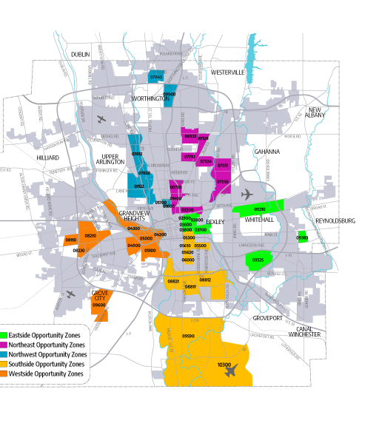
2022 Opportunity Ohio
Ohio Opportunity Zone Program
Federally designated underserved census tracts
Taxpayers invests capital gains taxes into Qualified Opportunity Zone Fund
QOZ invests in OZs
Taxpayers delays original capital gains tax and eliminates capital gains tax on OZ investment
Ohio offers a non-refundable tax credit equal to 10% of the number of its funds invested by the Ohio QOF in the QOZ Property and the Taxpayer may invest in multiple Ohio QOFs and may receive tax credits totaling up to $2 million dollars during the 2022-2023 biennium period

Slide 29
2022 Opportunity Ohio
Ohio Rent Control Law
Local governments are prohibited for enacting rent control or rent stabilization ordinances unless the property is owned by the political subdivision or is related to voluntary agreements or incentives to increase or maintain the supply or improve the quality of available residential premises to promote affordable housing provided under LIHTC or similar programs or where, in return for granting some type of tax abatement or credit, the city requires, and the owner agrees, to limit rents.
“Rent control” defined as “requiring below-market rents for residential premises or controlling rental rates for residential premises in any manner"
“Rent stabilization” is defined as “allowing rent increases for residential premises of a fixed amount or on a fixed schedule as set by a political subdivision”

Slide 30
2022 Opportunity Ohio
Industry Focus: Logistics Industry

Slide 31
2022 Opportunity Ohio
Global logistics market was worth $10.32 B in 2017, growing to $12.68 B 2023

Slide 32
2022 Opportunity Ohio
Opportunity Ohio 2022

Slide 33
2022 Opportunity Ohio
Opportunity Ohio 2022

Slide 34
2022 Opportunity Ohio

Slide 35
2022 Opportunity Ohio

Slide 36
2022 Opportunity Ohio
Industry Focus: Semiconductor Industry

Slide 37
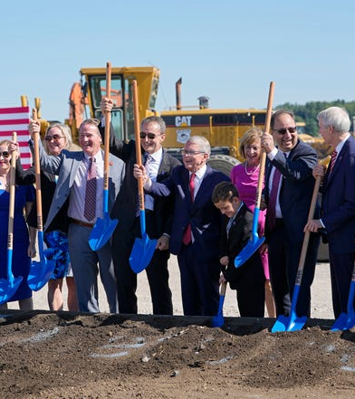
2022 Opportunity Ohio
Intel Ohio Semiconductor Project
Intel’s $20B “fab” facilities
Two new leading-edge chip factories in New Albany, Ohio
Intel pledged $100M toward workforce and R&D partnerships
3,000 Intel jobs by 2025 and 7,000 construction / skilled trades jobs
30-40 suppliers expected
Source: Columbus Dispatch

Slide 38
2022 Opportunity Ohio
What does it take to land a billion-dollar semiconductor chip site?
A site with minimal risk of natural disasters such as earthquakes, hurricanes or floods as the semiconductor fabrication process requires not just a perfectly clean site but a facility that has little chance of mother nature harming its efforts;
A site with access to substantial amounts of water;
A skilled workforce in science and technology;
A major, local research and development partner; and
A massive economic development incentive package

Slide 39
Semiconductor Industry – Workforce Impacts
Broad opportunity for Ohioans in manufacturing, engineering and skilled trades – both within the semiconductor industry and beyond
Intel will begin hiring Technicians and Engineers for the Ohio location in 2023/2024
There will be a surge in enrollment in Engineering and Manufacturing Technician programs
22K broad Technician & Operator Roles filled within 60 miles of the site in 2020
6.2K Engineer Roles posted in Ohio in last 30 days
Semiconductor manufacturing industry roles earn an average salary more than $10,000 above other popular sectors
Intel is bringing 3,000 new hi-tech manufacturing and engineering jobs, 7,000 construction jobs to Central OH
For individuals hired prior to 2025, Intel will offer 12-24 months of paid training in another Intel location, such as Arizona, for Ohio’s founding hires
Now is the time to join Ohio’s newest industry by enrolling in an Engineering or Manufacturing Technician program

Slide 40
2022 Opportunity Ohio
2022 Opportunity Ohio
Just the beginning? Demand expected to rise across product categories.

Slide 41
2022 Opportunity Ohio
Key provisions: Semiconductor/R&D Incentives
Appropriates $39B in direct subsidies for expanding semiconductor manufacturing, research, packaging, equipment, and materials capacity in the United States.
$19 billion is authorized for FY22, $2 billion of this for production of “legacy,” or less complex chips critical to auto/defense industries; for FY23–26, $5B per year.
25% tax credit for purchase, construction, manufacture, etc. of equipment or property for advanced chip manufacturing; may also be availale as a direct payment.
$11B toward R&D and workforce development, including: Nat’l Semiconductor Tech Center, Advanced Packaging Manufacturing Program, NIST programs on metrology and USA Manufacturing site; $25m annual for workforce development.
NSF/NIST authorizations (requiring annual appropriations): $81B for various programs to enhance STEM education, STEM workforce development and establish regional and local technology development resources

Slide 42
Key Program Requirements for recipients
Prohibited Country Investment Restrictions: Companies receiving assistance are prohibited from any “significant transaction” involving the “material expansion of semiconductor manufacturing capacity in People’s Republic of China.”
Tax Incentives: requirement of “Qualifying Projects and Properties” during specified time frame; eligibility as direct payments for those without sufficient tax liability to take credits.
Key Eligibility Requirements: state or local incentives for the project; provision of training/education benefits and employ economically disadvantaged individuals; and evidence that project is in the economic and national security interests of the United States and addresses identified gaps in the domestic supply chain.

Slide 43
2022 Opportunity Ohio
Industry Focus: Electric Vehicle Industry

Slide 44
2022 Opportunity Ohio

Slide 45
2022 Opportunity Ohio
EV Market Growth
Mercedes Benz 25 new plugin hybrid EVs to fully EV by 2025
GM plans 30 new global EVs by 2025
Toyota to produce 3.5 M EVs by 2030 to offer 30 EVs by 2030
Honda 40% zero emission sales goal by 2030
Daimler AG 70% of sales in Europe and over 40% in the U.S. to be low-emission vehicles (LEV) by 2030
$171.26 B in 2020 expected to reach $725.14 B by 2026
Ford spending $11.5 B on EVs through 2022

Slide 46
2022 Opportunity Ohio
Largest EV Project Announcements
Company | Location | Capex ($M) | Jobs
Ford Motor Company & SK Innovation | Hardin, KY | $5,800 | 5,000
Ford Motor Company & SK Innovation | Stanton, TN | $5,600 | 6,000
Hyundai Motor Group | Bryan County, GA | $5,500 | 8,100
Rivian | Fort Worth, TX | $5,000 | 7,500
General Motors | Orion, MI | $4,000 | 2,350
General Motors & LG Energy Solution | Lansing, MI | $2,600 | 1,700
SK Innovation | Commerce, GA | $2,600 | 3,000
Stellantis & Samsung | Kokomo, IN | $2,500 | 1,400
General Motors & LG Energy Solution | Spring Hill, TN | $2,300 | 1,300
General Motors & LG Energy Solution | To be announced | $2,100 | Not available
Panasonic | De Soto, KS | $4,000 | 4,000
Envision AESC | Bowling Green, KY | $2,000 | 2,000
Ford Motor Company | Multiple sites, MI | $2,000 | 3,200
VinFast | Chatham County, NC | $2,000 | 7,500
LG Energy Solution | Holland, MI | $1,700 | 1,200
LG Energy Solution | Queen Creek, AZ | $1,400 | Not available
Toyota Motor Corporation | Liberty, NC | $1,290 | 1,750
Tesla | Austin, TX | $1,100 | 5,000
Toyota Motor Corporation | Princeton, IN | $803 | 1,400
Volkswagen | Chattanooga, TN | Not available | Not available
TOTAL |  | $54,293 | 62,400

Slide 47
2022 Opportunity Ohio
Ohio EV Economic Development Incentives
Tax Increment Financing
Ohio 629 Roadwork Grants
JobsOhio Revitalization Program
Joint Economic Development Districts
Ohio Job Creation Tax Credit
Tax Abatement
JobsOhio Growth Fund
JobsOhio Research and Development Center Grant
JobsOhio Workforce Grant
Ohio MegaProject Incentive

Slide 48
2022 Opportunity Ohio
Questions?
Contact
drobinson@montrosegroupllc.com
ngreen@montrosegroupllc.com
jbgrant@montrosegroupllc.com
tbiggam@montrosegroupllc.com
hcrume@montrosegroupllc.com

