Slide 1
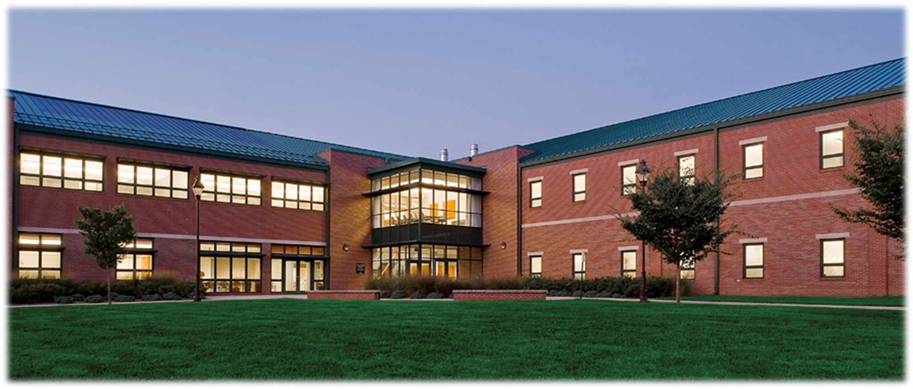

Slide 2
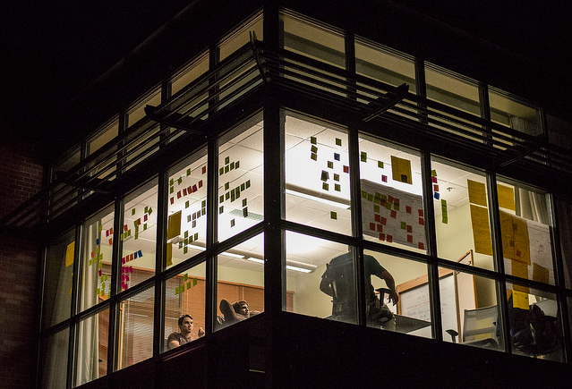
Innovation Center Video
https://www.youtube.com/watch?time_continue=6&v=Bb9M7noLk5o

Slide 3
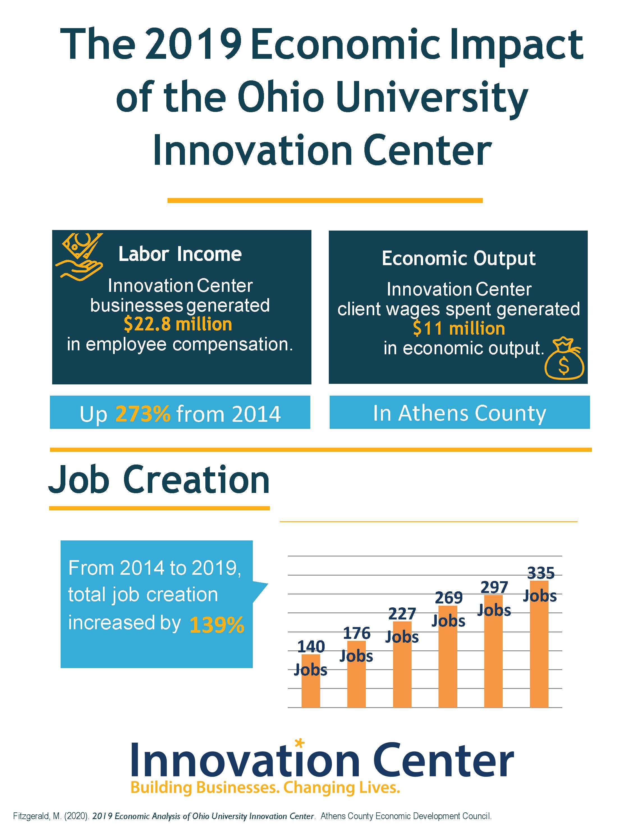

Slide 4
Recent Awards
Named the Best Support of Entrepreneurial Innovation by APEG (2019)
Named the Randall M. Whaley Incubator of the Year by InBIA. (2019)
Named the Rural Incubator of the Year by InBIA. (2019)
Selected by the International Business Innovation Association (InBIA) as a Global Soft Landings designee. (2017)
UBI Global, a Sweden-based benchmarking institute ranked the IC as a Top University Business Incubator - #3 in the United States; #8 in North America. (2016)
Named Rural Incubator of the Year by InBIA. Ecolibrium Solar was named Outstanding Incubator Graduate: Hard Science. (2016)

Slide 5
Recent Grants
Awarded a $100K USDA grant for sector business development. (2020)
Awarded a $1.2M federal grant for infrastructure upgrades. (2019)
Awarded a $150K state grant for Additive Manufacturing equipment. (2017-19)
Awarded a $100K USDA grant for biotechnology equipment. (2018)
Awarded a $2M grant from the Appalachian Regional Commission to replicate and expand IC success into broader region and sectors via LIGHTS Regional Innovation. (2016)

Slide 6
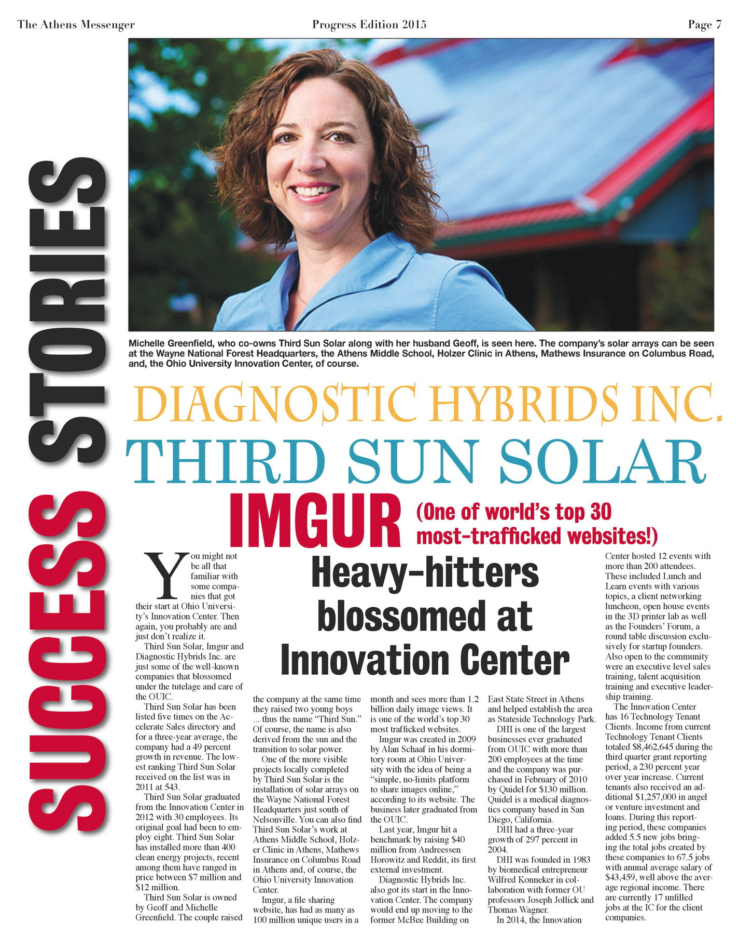
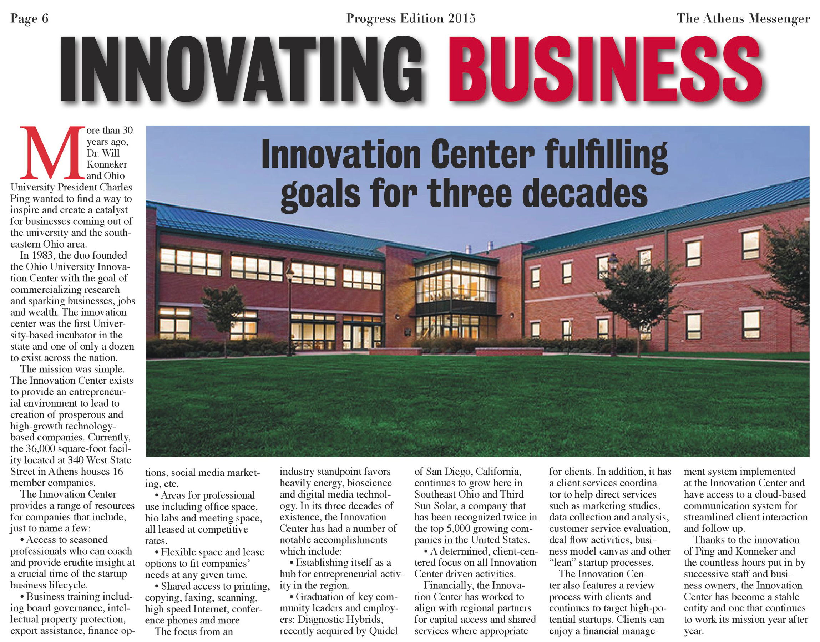
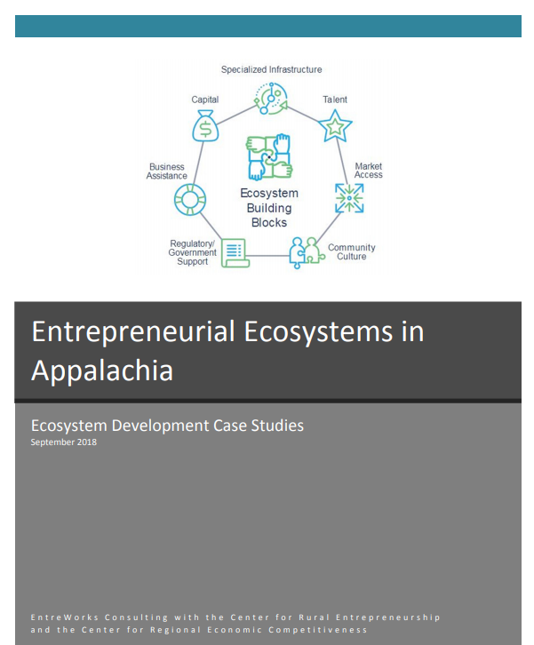
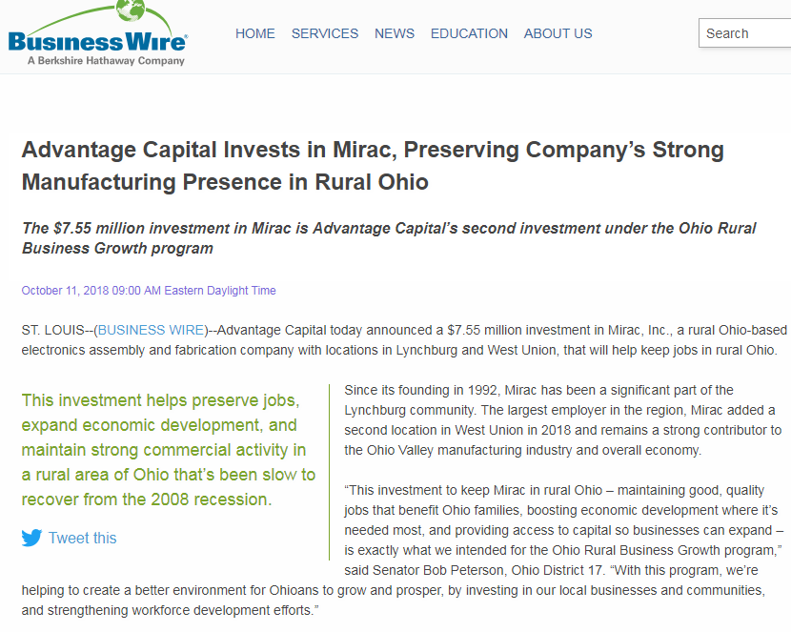
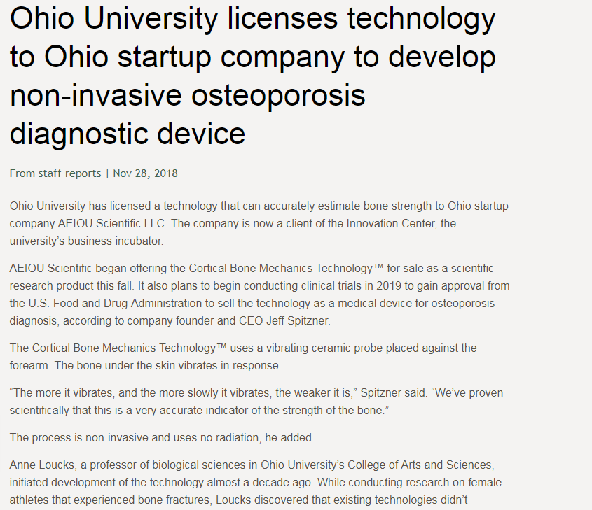
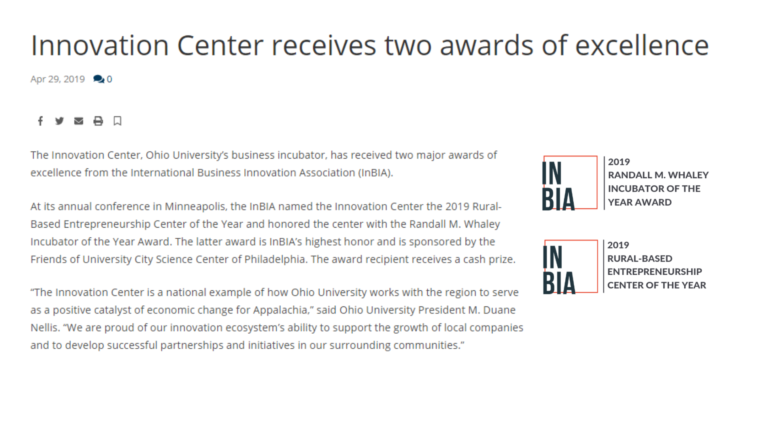
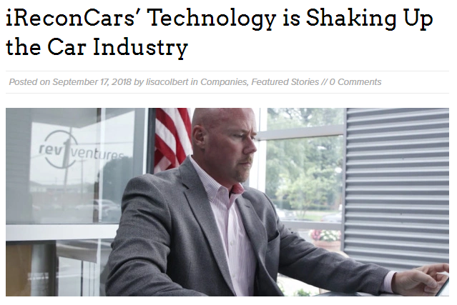
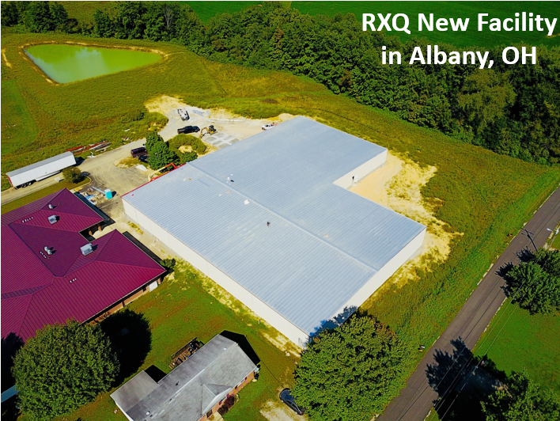
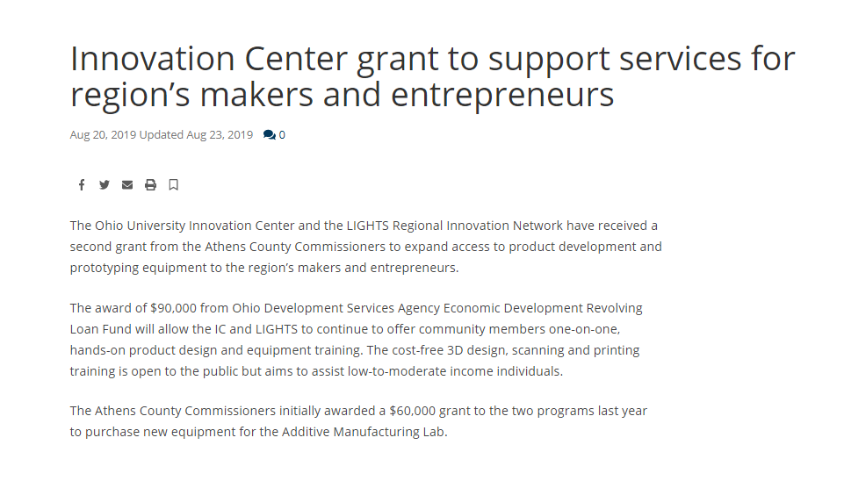
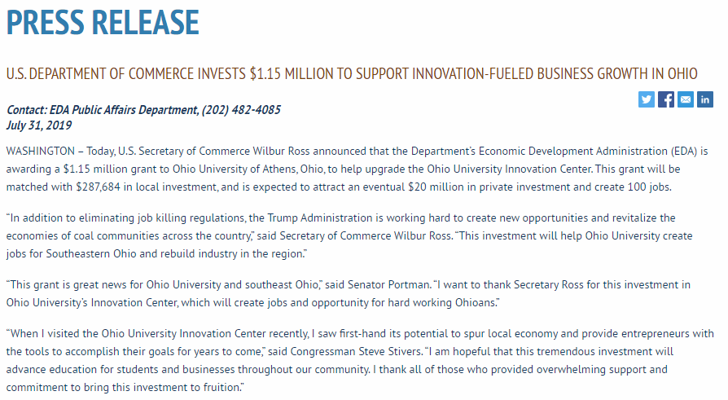
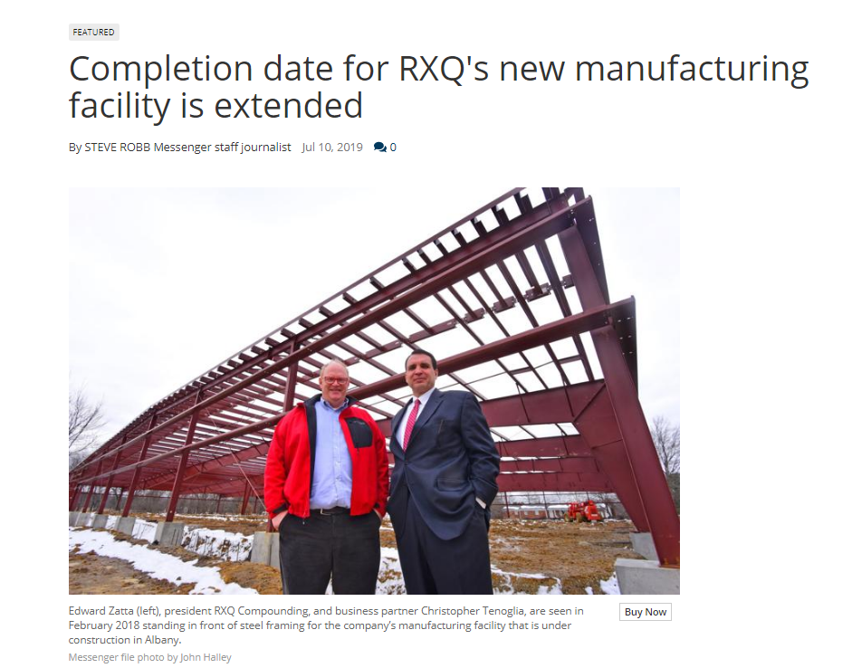
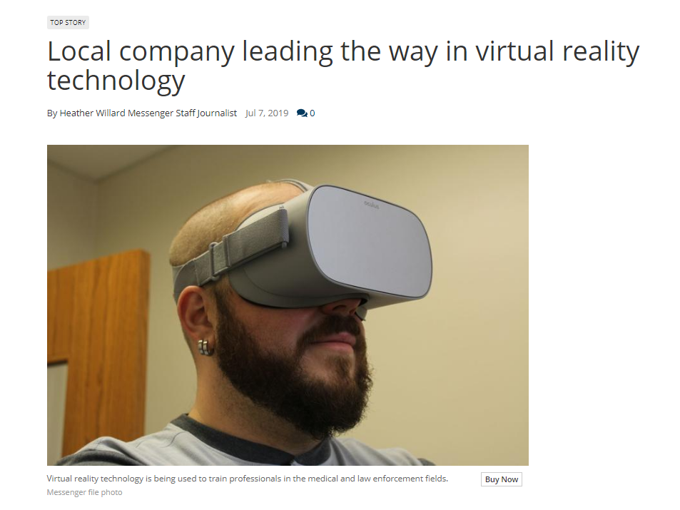
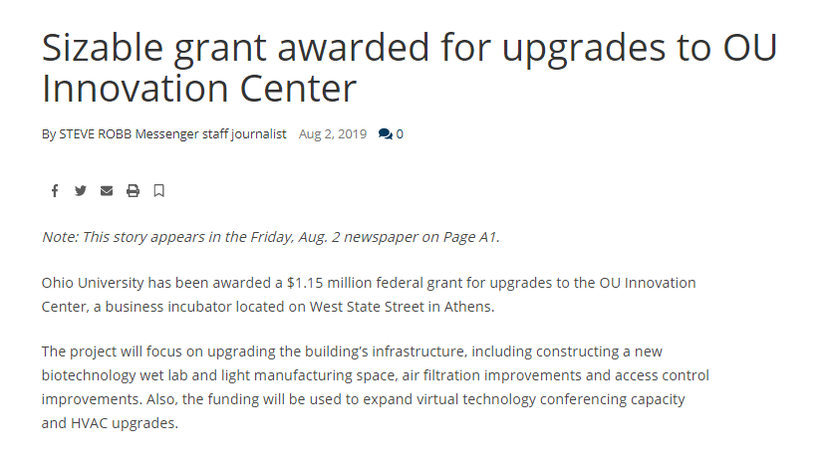
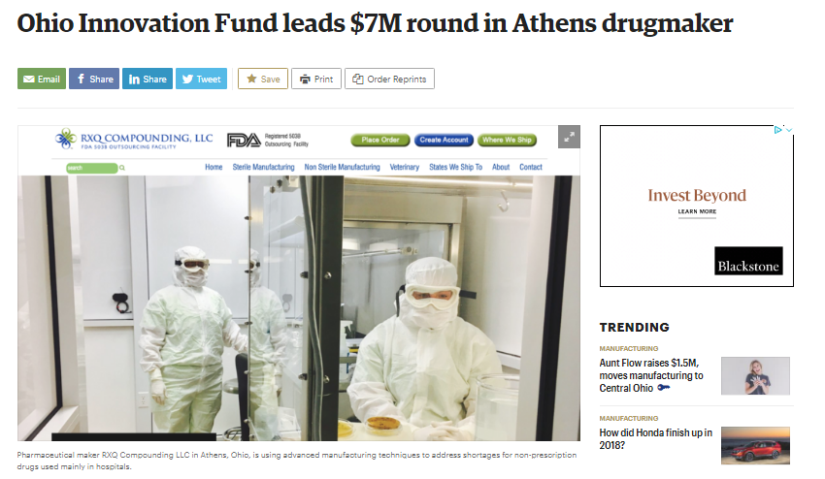
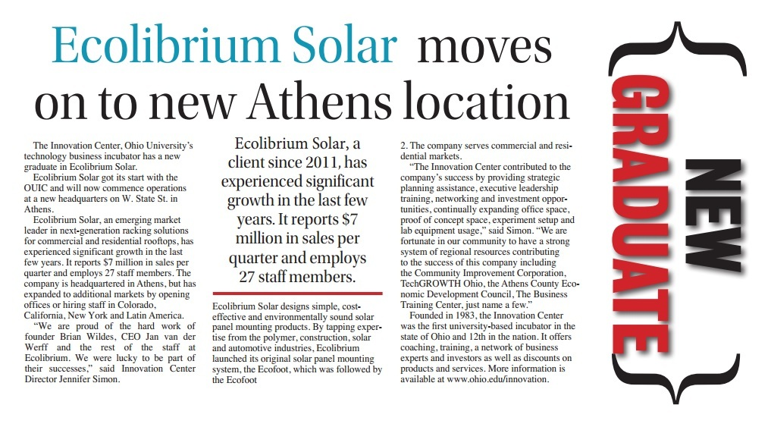
Notes:
We help early stage companies develop wealth and create jobs by providing strategic business assistance, facilities, training and networking
Awards: Ranked 3rd Best North American University Based Incubator of 2015; 2016 Rural Incubator of the Year (International Business Innovation Association)
Currently serving 9 TECHNOLOGY client companies with a mix of complementary anchor tenants
Sectors: energy, biotech, transportation, IT, other
Viable, scalable business
Job growth potential
Coachable
You will learn more about our facility during the tour

Slide 7
Notes:
We help early stage companies develop wealth and create jobs by providing strategic business assistance, facilities, training and networking
Awards: Ranked 3rd Best North American University Based Incubator of 2015-17; 2016 Rural Incubator of the Year (International Business Innovation Association)
Currently serving 10 TECHNOLOGY, TECH ENABLED OR PRODUCT BASED client companies with a mix of complementary anchor tenants
Sectors: energy, biotech, life sciences, surveillance, cyber security, residential use products, commercial products, IT, other
Viable, scalable business
Job growth potential
Coachable
You will learn more about our facility during the tour

Slide 8
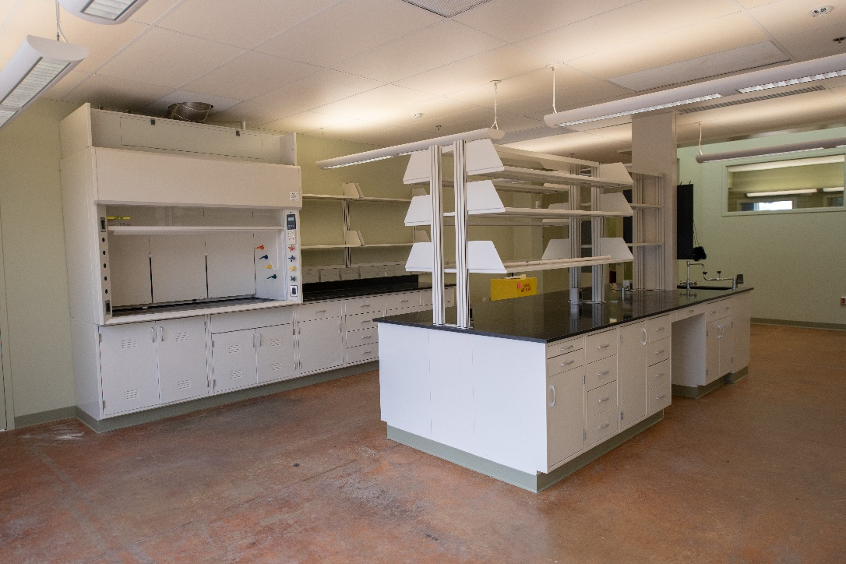
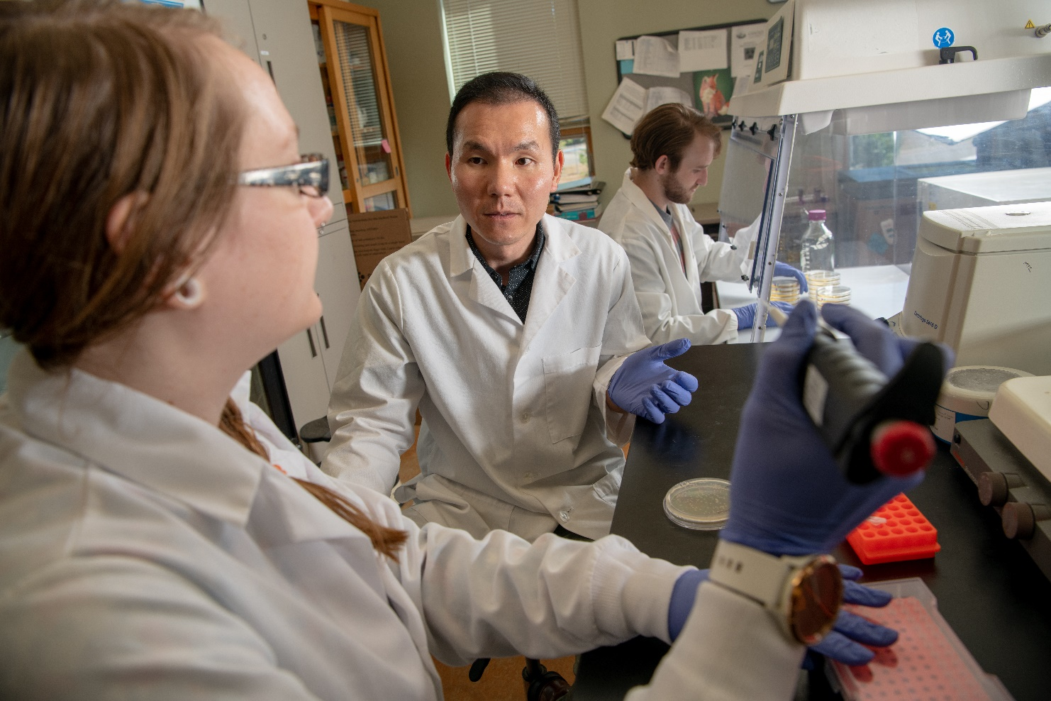
Micro-Cluster Build Out

Slide 9
Let the Data Direct You
Sector Average Salary 5 Year History Change
Pharmaceutical $48,039 +1.71
Preparation
Manufacturing
In-Vitro
Diagnostic
Substance
Manufacturing $57,949 +51.65
R&D in Life
Sciences $62,655 +1.06

Slide 10
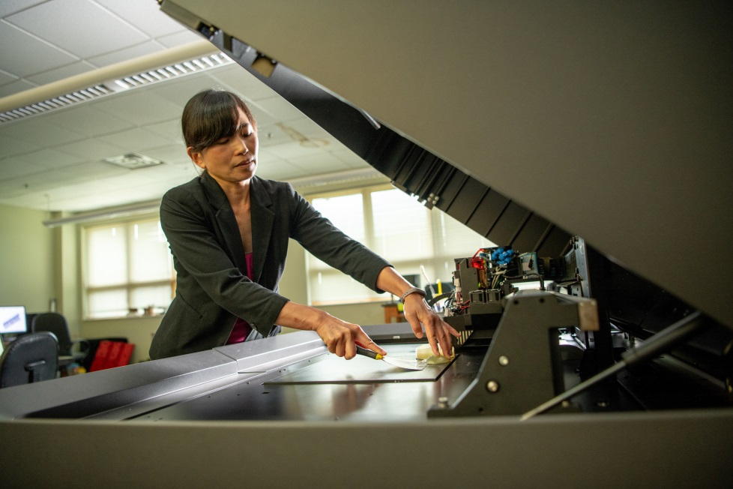
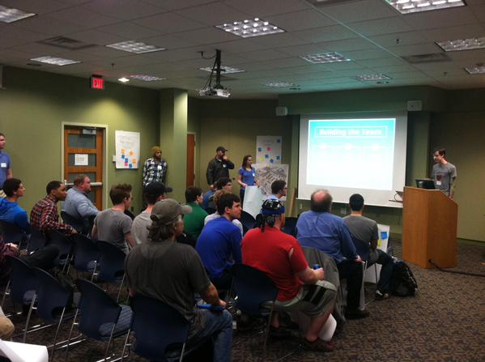
IC Key Client Resources: Space, Expertise, Talent, Cost Savings, and Access to Capital
Fulltime Client Services Manager & Executive Coach
Fulltime Lab Director
Team of shared Executives-in-Residence (EIRs)
Student Workforce
Traditional finance: banks
Crowdfunding Assistance
Angel & Venture Capital Investment Connections
Product Development
SBDC Supported Loan Assistance
Microloan Assistance (ACEDC and others)
Negotiated vendor discounts
Notes:
Turning ideas into reality requires capital
Bootstrapping: relying on customer revenue, penny-pinching, and even using personal credit cards to make ends meet
Crowdfunding: Kickstarter; individuals to make contributions in receipt of MVP (validation)
Friends and Family (and, fools LOL) :invest very early; with an Idea…invest in YOU rather than in your company
VC: private equity investments with substantial risk; band together as group; VCs typically have a say in business activities, >$500k
Angel: high net worth individual < $500K
SBDC, SBA programs / HUB Zone Access / Microloans / STTR, SBIR

Slide 11
Funders

Slide 12
Questions?
Stacy Strauss, Director
Ohio University Innovation Center
strauss@ohio.edu

