Slide 1
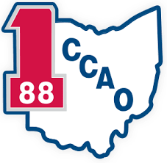

COVID 19 Economic Recovery Strategy
The Montrose Group, LLC

Slide 2
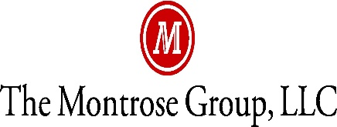
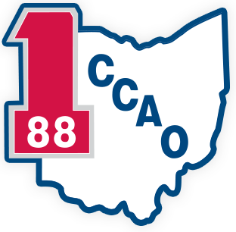
Ohio Economic Development Association
Montrose Group COVID 19 Economic
Recovery Strategy

Slide 3


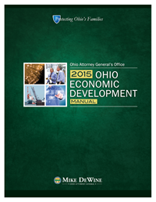
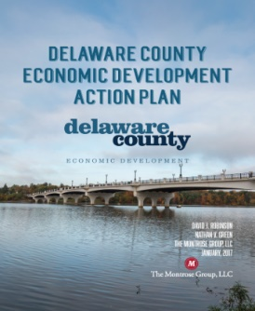
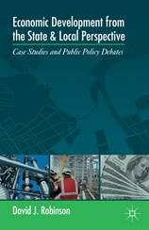
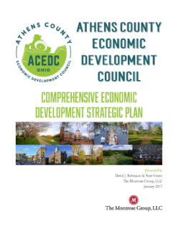
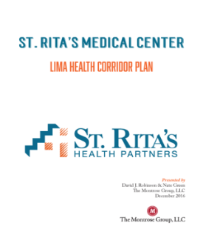
Montrose Group COVID 19 Economic Recovery Strategy
Montrose Group, LLC Wrote the Book on Economic Development

Slide 4
Montrose Group COVID 19 Economic
Recovery Strategy
Economic Recovery
1. Assess the Damage
2. Keeping Companies Alive
4. Tax Incentive Flexibility
5. Site Development
3. Build Regional Financing Mechanisms

Slide 5
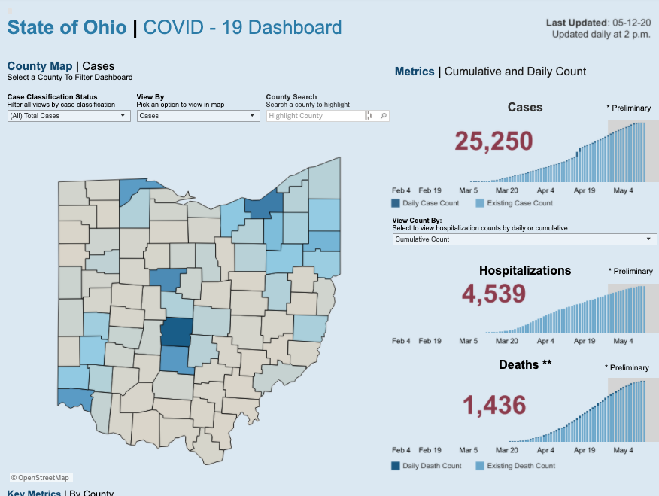
Montrose Group COVID 19 Economic Recovery Strategy

Slide 6
Montrose Group COVID 19 Economic Recovery Strategy

Slide 7
Montrose Group COVID 19 Economic Recovery Strategy

Slide 8

Montrose Group COVID 19 Economic Recovery Strategy
Ohio’s Safe Business Practices for Getting Back to Work
Recommend face coverings
For employees and clients/customers at all times
Conduct daily health assessments
By employers and employees (self-evaluation) to determine if “fit for duty”
Maintain good hygiene
At all times-hand washing and social distancing
Clean and sanitize
Workplaces throughout workday and at the close of business or between shifts
Limit capacity to meet social distancing guidelines
Establish maximum capacity at 50% of fire code
And, use appointment setting where possible to limit congestion

Slide 9
Montrose Group COVID 19 Economic Recovery Strategy
Ohio Back to Work Timeframe
May 12th
Ohio’s hospitals and healthcare permitted to perform all medical outpatient procedures
May 4th
Manufacturing
Distribution
Construction
General office operations
Consumer
Retail
Services
May 1st

Slide 10
Montrose Group COVID 19 Economic Recovery Strategy
Factors Impacting Company Reopening Decision
Depth of Market Disruption
Preparation of workplace
Length of Market Disruption
Increase or decline of COVID 19 cases
Shape of Market Recovery
Integration of data driven public health policy with private sector economic activation
COVID 19 cases at company
Location of company COVID 19 cases
Customer market demand
Hospital preparedness
Availability of therapies
Late customer payments
Access to capital
Availability of rapid testing technology for health care providers and companies
Re-establishment of consumer confidence
Impact of on-going public health regulations

Slide 11
Montrose Group COVID 19 Economic Recovery Strategy

Slide 12
Montrose Group COVID 19 Economic Recovery Strategy

Slide 13

Montrose Group COVID 19 Economic Recovery Strategy
EDA’s Economic Adjustment Assistance (EAA) Program
$1.5B in supplemental funding for the Economic Adjustment Assistance program
Funds technical, planning, and public works and infrastructure assistance
Regions experiencing adverse economic changes that occur suddenly or over time

Slide 14
Montrose Group COVID 19 Economic Recovery Strategy
CARES Act EDA EAA Opportunities
Notice of Funding Opportunity (NOFO)
CARES Act NOFO increases funding ceiling to $30M; award floor remains $100,000
Assistance to help communities prevent, prepare for, and respond to impacts of COVID 19
Open funding cycle

Slide 15
Montrose Group COVID 19
Economic Recovery Strategy
$5B in COVID 19 federal stimulus CDBG funding
$2B distributed by 2020 allocation to large cities and states
$1B distributed to states in 45 days to combat COVID 19
$2B distributed to states for longer term economic and housing disruptions

Slide 16
Montrose Group COVID 19 Economic Recovery
Strategy
CDBG Fund Uses
Infrastructure
Economic development projects
Public facilities installations
Community centers
Housing rehabilitation
Public services
Microenterprise assistance
CDBG Funds Rules
Typically funds up to 50% of total project costs
Loans and grants are made based on a certain $$ for every full-time equivalent job created or retained as a result of the project
Public infrastructure projects (e.g., water, sewer, roads) are eligible for up to 50% CDBG grant funding
Private, for-profit projects can qualify for up to 50% CDBG low-interest loans

Slide 17
Montrose Group COVID 19 Economic Recovery Strategy
CDBG Case Studies
City of Neodesha, KS CDBG + USDA
City Gas System Upgrades
$2.3M Total Project Cost
$600,000 CDBG Grant
$1.76M USDA Rural Development Grant
Public infrastructure upgrades to service 2,500 residents and businesses in community
Highland County Ohio CDBG RLF
Corvac Composites, LLC new automotive manufacturing facility sited in Highland County
$12.5M Total Project Cost
$500,000 CDBG RLF
$12M Outside Funding
Total Jobs Created – 55
29 LMI Jobs (52.7%) - $9,090/job created

Slide 18
Montrose Group COVID 19 Economic Recovery Strategy
Federal Stimulus & USDA Rural Development
$48.9 B to USDA – Close the “digital divide” in America’s rural communities
$145 M USDA’s Rural Development programs
$20.5 M for the Rural Business-Cooperative Service, adding $1 B in lending authority
$100 M in grants for Rural Broadband Service
$25 M for Distance Learning and Telemedicine Programs

Slide 19
Montrose Group COVID 19 Economic Recovery Strategy
Rural Development Broadband ReConnect Loan and Grant Program
Loans and grants
Construction, improvement, or acquisition of facilities and equipment needed to provide broadband service in eligible rural areas that do not have access to at least 10 Mbps downstream and 1 Mbps upstream
100% Grant – up to $25,000,000 max grant request
50% Loan / 50% Grant – up to $25,000,000 loan and $25,000,000 grant request and loan/grant requests will always be equal
100% Loan – up to $50,000,000 max loan request
Eligible Applicants
Cooperatives, non-profits, or mutual associations, for-profit corporations, state or local governments, territory or an Indian tribe

Slide 20
Montrose Group COVID 19 Economic Recovery Strategy
USDA DLT Case Studies
Owensboro Health Inc. received $460,820 grant to install telemedicine equipment at 10 sites in Kentucky and Indiana. The equipment expands health care resources to ~35,000 residents, including ~2,000 patients.
Lisbon (OH) Exempted Village School District received $323,478 to create distance learning network at 8 sites in Columbiana County. District is offering classes and behavioral health services to 850 students.
USDA Rural Broadband Case Study
Logan Telephone Cooperative Inc. received a $34.4 M USDA Telecommunications Program loan to upgrade a FTTH system in Butler, Logan and Muhlenberg counties in southwestern Kentucky
Morton County, N.D., USDA is partnering with BEK Communications Cooperative to provide an $844,000 Community Connect Program grant for a 49-mile Fiber-to-the-Home network will bring high-speed broadband to 125 underserved households
SW Virginia, iGo Technology Inc. received a $3 M Community Connect grant to bring enhanced broadband opportunities to 820 homes and businesses giving the Bee Community Center, in the town of Bee in Dickenson County, free broadband for two years

Slide 21
Montrose Group COVID 19 Economic Recovery Strategy
Federal Stimulus “3.5” Overview
$484 B in COVID 19 federal stimulus “3.5” funding
$321 B replenishing Paycheck Protection Program
$60 B set aside for underbanked businesses
$250 B unrestricted
$60 B in additional SBA EIDL funding for loans ($50 B) and grants ($10 B)
$75 B for hospitals to cover increased expenses and lost revenue
$25 B for COVID 19 testing, of which $11 B will go to states and federal government to develop, purchase, administer, process and analyze tests
~$2 B for SBA administrative expenses
$150 B request for state and local government aid not included

Slide 22
Montrose Group COVID 19 Economic Recovery Strategy

Slide 23

Montrose Group COVID 19 Economic Recovery Strategy
JobsOhio COVID 19 Impact Plan
$250 M PPE Purchases
$7 M Liquor Rebate
$30 M Liquor Buy Back
$4 M 6-Month Loan Deferment
$50 Workforce Retention Loan
$50 M Commercial Bank Loan Program
$2 M Appalachian Capital Program
$50 M JobsOhio Innovation Fund
$50 M Port Authority Reserve Fund
$10 M Air Service Restoration

Slide 24
Montrose Group COVID 19 Economic Recovery Strategy
Economic Development Incentive Reporting and Managing Job & Capital Investment Commitments
Market Conditions and Other Factors
Economic development incentive agreements gives the government or economic development organization partner the ability to keep the incentive agreement in place if the company does not meet its economic development commitments due to factors outside of their control
Force Majeure
Common Law notion that gives the ability of parties to a contract to be excused from their obligations when certain circumstances arise beyond the party’s control making performance inadvisable, commercially impracticable, illegal, or impossible
Extreme events such as epidemics or pandemics, along with war, terrorist attacks, “acts of God,” famine, strikes, and fire in the list of events excusing overall performance or delay in performance

Slide 25
Montrose Group COVID 19 Economic Recovery Strategy
Longer Term
Site Development
Post COVID 19 Industry Targets
Post COVID 19 Supply Chain Development

Slide 26
Montrose Group COVID 19 Economic Recovery Strategy
COVID 19 Creates Opportunity for Site Development
Land Use Entitlements
Tax Incentives
Joint Economic Development Districts
Zoning
Annexation
Easements
Tax Abatements
Tax Credits
Infrastructure Finance
Tax Increment Financing
Local and State Grants
School Compensation Agreements
School Compensation Agreements
Constructing Financing
Construction Material Sales Tax Exemption
Transportation Improvement Districts

Slide 27
Montrose Group COVID 19 Economic Recovery Strategy
Post-COVID 19 Industry Winners
E-Commerce
Logistics
Medical Equipment Manufacturers
PhRMA
Post-COVID 19 Industry Losers
Traditional brick & mortar retail
Airlines
Events
Hospitality

Slide 28
Montrose Group COVID 19 Economic Recovery Strategy
Ohio Site Improvement Funding Options
Ohio Rural Industrial Loan Program
JobsOhio Revitalization Program
JobsOhio OSIP
Joint Economic Development Districts
Ohio 629 Roadwork Grants
Community Development Block Grant
Economic Development Administration
JobsOhio/OhioSE Site Initiative
Ohio Department of Transportation Jobs and Commerce
Tax Increment Financing

Slide 29
Montrose Group COVID 19 Economic Recovery Strategy
Summit County Case Study
Delaware County Case Study

Slide 30

Summit County COVID-19 Small Business Emergency Relief Grant Program
Who created the fund and for what reason?
Initiated with $750K from Summit County - $530K in general funds and $220K County CDBG dollars
Local municipalities and townships contributed over $300K in support and $100K in additional CDBG funds
Private and philanthropic sources added over $400K in funding
For every Summit County dollar, there was at least one additional dollar from other funders
City and Municipality funding was able to be restricted to their communities
Authorized by Summit County Council on March 30, the grant program was designed to provide grants of up to $5,000 to small for-profit businesses impacted by COVID-19.
Funds can be used for any deductible business expense

Slide 31
Summit County COVID-19 Small Business Emergency Relief Grant Program
What businesses were eligible?
Have applied for either the SBA EIDL or PPP COVID Relief loan programs
Must be a for profit business with its principal place of business located within the County of Summit.
In operation for at least one year prior to
March 15, 2020
Employ 3-25 individuals, with at least 50% of those employees being permanent residents of Summit County
The business must be current on all Summit County municipal and Joint Economic Development District income tax obligations and Summit County property tax obligations.

Slide 32

Summit County COVID-19 Small Business Emergency Relief Grant Program
Objective Evaluation Rubric

Slide 33
Summit County COVID-19 Small Business Emergency Relief Grant Program
Who got grants?
1,046 Submissions; 610 eligible; 311 awarded; $1,546,178 in grants
We awarded 147 disadvantaged businesses (147 of 311 = 47%)
35% of DBE applicants were awarded, compared to 26% of non-DBE applicants
32% of Black-owned business applicants were eligible, 55% of WBE applicants were eligible 60% of non-Black and non-WBE owned business applicants
88% of eligible Black-owned applicants were awarded, 61% eligible WBE applicants awarded
56% of awardees have 3-7 employees; 44% have 8-25 employees
54% of awardees have $250k - $1m in revenue; 5% have less than $100k, 19% have $100k-$250k, and 22% have over $1m
73% of our awardees are located in either a LMA or Job Hub (28% in Job Hub; 65% in LMA; 19% in both Job Hub and LMA)

Slide 34
Summit County COVID-19 Small Business Emergency Relief Grant Program
Round 2 Opens Thursday, May 14th
Funded with $5 million in CARES Act dollars
Removed SBA EIDL or PPP COVID Relief loan application requirements
Changed employee size eligibility to 2 – 30 employees
Added single employee $2,000 grant program with allowance for revenue replacement
Approximately $1.4 million will be used to fund existing applicants who were eligible in round 1 but not funded.
Approximately $1.0 million will be used to fund existing applicants who are rescored and may be deemed eligible
Approximately $1.6 million will be used to fund $5,000 grants to new applicants
Approximately $1.0 million will be used to fund $2,000 grants to new applicants

Slide 35
Questions
Thoughts
Contact
drobinson@montrosegroupllc.com
ngreen@montrosegroupllc.com
jbgrant@montrosegroupllc.com
tbiggam@montrosegroupllc.com
Montrose Group COVID 19 Economic Recovery Strategy

