Slide 1


COVID 19 Economic Recovery Strategy
The Montrose Group, LLC

Slide 2
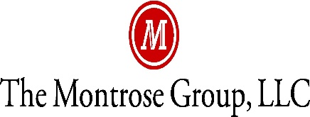
Ohio Economic Development Association
Montrose Group COVID 19 Economic
Recovery Strategy

Slide 3


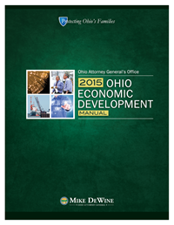
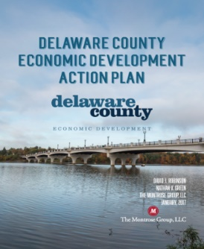
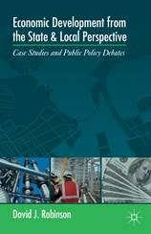
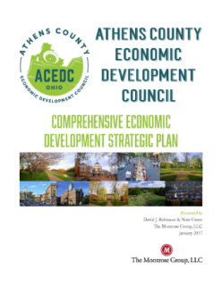
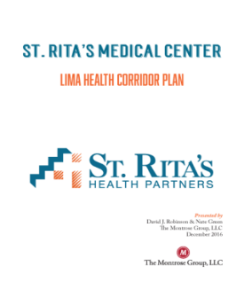
Montrose Group COVID 19 Economic Recovery Strategy
Montrose Group, LLC Wrote the Book on Economic Development

Slide 4
Montrose Group COVID 19 Economic
Recovery Strategy
Economic Recovery
1. Assess the Damage
2. Keeping Companies Alive
4. Tax Incentive Flexibility
5. Site Development
3. Build Regional Financing Mechanisms

Slide 5
Montrose Group COVID 19 Economic Recovery Strategy

Slide 6
Montrose Group COVID 19 Economic Recovery Strategy

Slide 7
Montrose Group COVID 19 Economic Recovery Strategy

Slide 8
Montrose Group COVID 19 Economic Recovery Strategy

Slide 9
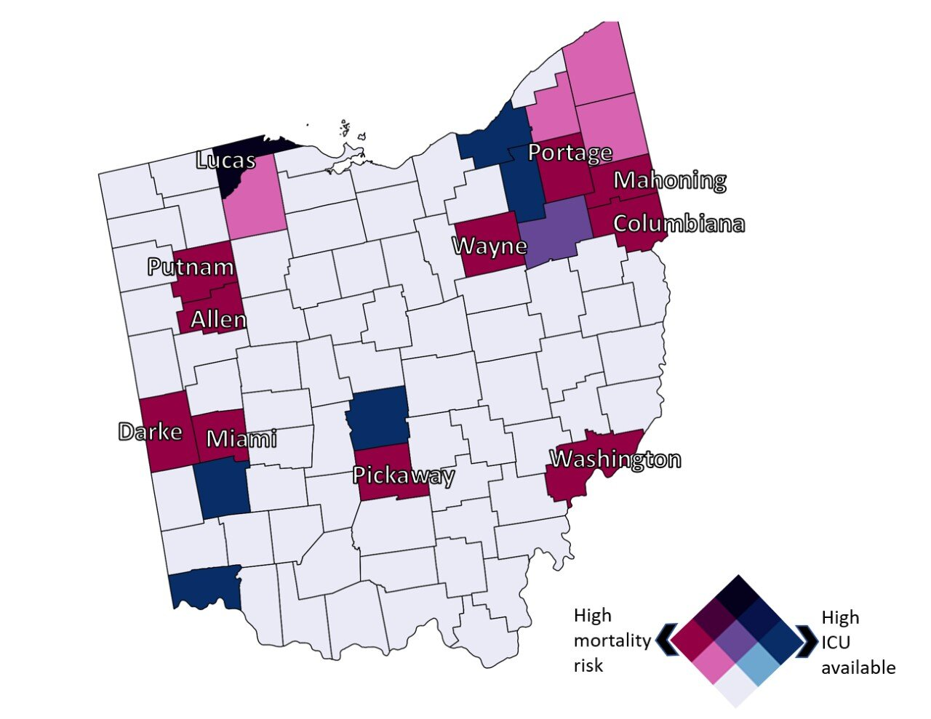
Montrose Group COVID 19 Economic Recovery Strategy
University of Cincinnati COVID 19
High Risk Counties

Slide 10
Montrose Group COVID 19 Economic Recovery Strategy

Slide 11
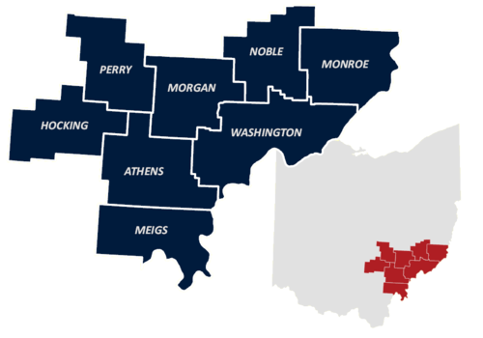
Montrose Group COVID 19 Economic Recovery Strategy

Slide 12
Montrose Group COVID 19 Economic Recovery Strategy
Demographic Fact | Buckeye Hills | Ohio | United States
Population | 255,129 | 11,689,100 | 328,239,523
Population change 2010-19 | -2.64% | 1.30% | 6.30%
Population over 65 | 20.28% | 17.10% | 16.00%
Homeownership rate | 74.55% | 66.00% | 63.80%
Median home value | $109,300 | $140,000 | $204,900
Median residential rent | $630 | $788 | $1,023
Bachelor's degree or higher | 15.29% | 27.80% | 31.50%
Median household income | $45,237 | $54,533 | $60,293
Per capita income | $23,939 | $30,304 | $32,621
Poverty Rate | 18.01% | 13.90% | 11.80%

Slide 13

Montrose Group COVID 19 Economic Recovery Strategy
Ohio’s Safe Business Practices for Getting Back to Work
Recommend face coverings
For employees and clients/customers at all times
Conduct daily health assessments
By employers and employees (self-evaluation) to determine if “fit for duty”
Maintain good hygiene
At all times-hand washing and social distancing
Clean and sanitize
Workplaces throughout workday and at the close of business or between shifts
Limit capacity to meet social distancing guidelines
Establish maximum capacity at 50% of fire code
And, use appointment setting where possible to limit congestion

Slide 14
Montrose Group COVID 19 Economic Recovery Strategy
Governor DeWine’s Dates Industries Can Open
Industry | Date
Elective medical procedures including vet’s and dentist operation | May 1, 2020
Manufacturing, distribution, construction and general office operation | May 4, 2020
Consumer, retail and service | May 12, 2020
Restaurants with outdoor dining | May 15, 2020
Barbers, salons, message therapy, acupuncture, and cosmetics | May 15, 2020
Restaurants with indoor dining | May 21, 2020
Campgrounds | May 21, 2020
Gyms, fitness centers, limited contact sports | May 26, 2020
Childcare centers | May 31, 2020

Slide 15
Montrose Group COVID 19 Economic Recovery Strategy
Factors Impacting Company Reopening Decision
Depth of Market Disruption
Preparation of workplace
Length of Market Disruption
Increase or decline of COVID 19 cases
Shape of Market Recovery
Integration of data driven public health policy with private sector economic activation
COVID 19 cases at company
Location of company COVID 19 cases
Customer market demand
Hospital preparedness
Availability of therapies
Late customer payments
Access to capital
Availability of rapid testing technology for health care providers and companies
Re-establishment of consumer confidence
Impact of on-going public health regulations

Slide 16
Montrose Group COVID 19 Economic Recovery Strategy

Slide 17
Montrose Group COVID 19 Economic Recovery Strategy

Slide 18

Montrose Group COVID 19 Economic Recovery Strategy
EDA’s Economic Adjustment Assistance (EAA) Program
$1.5B in supplemental funding for the Economic Adjustment Assistance program
Funds technical, planning, and public works and infrastructure assistance
Regions experiencing adverse economic changes that occur suddenly or over time

Slide 19
Montrose Group COVID 19 Economic Recovery Strategy
CARES Act EDA EAA Opportunities
Notice of Funding Opportunity (NOFO)
CARES Act NOFO increases funding ceiling to $30M; award floor remains $100,000
Assistance to help communities prevent, prepare for, and respond to impacts of COVID 19
Open funding cycle

Slide 20
Montrose Group COVID 19
Economic Recovery Strategy
$5B in COVID 19 federal stimulus CDBG funding
$2B distributed by 2020 allocation to large cities and states
$1B distributed to states in 45 days to combat COVID 19
$2B distributed to states for longer term economic and housing disruptions

Slide 21
Montrose Group COVID 19 Economic Recovery
Strategy
CDBG Fund Uses
Infrastructure
Economic development projects
Public facilities installations
Community centers
Housing rehabilitation
Public services
Microenterprise assistance
CDBG Funds Rules
Typically funds up to 50% of total project costs
Loans and grants are made based on a certain $$ for every full-time equivalent job created or retained as a result of the project
Public infrastructure projects (e.g., water, sewer, roads) are eligible for up to 50% CDBG grant funding
Private, for-profit projects can qualify for up to 50% CDBG low-interest loans

Slide 22
Montrose Group COVID 19 Economic Recovery Strategy
CDBG Case Studies
City of Neodesha, KS CDBG + USDA
City Gas System Upgrades
$2.3M Total Project Cost
$600,000 CDBG Grant
$1.76M USDA Rural Development Grant
Public infrastructure upgrades to service 2,500 residents and businesses in community
Highland County Ohio CDBG RLF
Corvac Composites, LLC new automotive manufacturing facility sited in Highland County
$12.5M Total Project Cost
$500,000 CDBG RLF
$12M Outside Funding
Total Jobs Created – 55
29 LMI Jobs (52.7%) - $9,090/job created

Slide 23
Montrose Group COVID 19 Economic Recovery Strategy
Federal Stimulus & USDA Rural Development
$48.9 B to USDA – Close the “digital divide” in America’s rural communities
$145 M USDA’s Rural Development programs
$20.5 M for the Rural Business-Cooperative Service, adding $1 B in lending authority
$100 M in grants for Rural Broadband Service
$25 M for Distance Learning and Telemedicine Programs

Slide 24
Montrose Group COVID 19 Economic Recovery Strategy
Rural Development Broadband ReConnect Loan and Grant Program
Loans and grants
Construction, improvement, or acquisition of facilities and equipment needed to provide broadband service in eligible rural areas that do not have access to at least 10 Mbps downstream and 1 Mbps upstream
100% Grant – up to $25,000,000 max grant request
50% Loan / 50% Grant – up to $25,000,000 loan and $25,000,000 grant request and loan/grant requests will always be equal
100% Loan – up to $50,000,000 max loan request
Eligible Applicants
Cooperatives, non-profits, or mutual associations, for-profit corporations, state or local governments, territory or an Indian tribe

Slide 25
Montrose Group COVID 19 Economic Recovery Strategy
USDA DLT Case Studies
Owensboro Health Inc. received $460,820 grant to install telemedicine equipment at 10 sites in Kentucky and Indiana. The equipment expands health care resources to ~35,000 residents, including ~2,000 patients.
Lisbon (OH) Exempted Village School District received $323,478 to create distance learning network at 8 sites in Columbiana County. District is offering classes and behavioral health services to 850 students.
USDA Rural Broadband Case Study
Logan Telephone Cooperative Inc. received a $34.4 M USDA Telecommunications Program loan to upgrade a FTTH system in Butler, Logan and Muhlenberg counties in southwestern Kentucky
Morton County, N.D., USDA is partnering with BEK Communications Cooperative to provide an $844,000 Community Connect Program grant for a 49-mile Fiber-to-the-Home network will bring high-speed broadband to 125 underserved households
SW Virginia, iGo Technology Inc. received a $3 M Community Connect grant to bring enhanced broadband opportunities to 820 homes and businesses giving the Bee Community Center, in the town of Bee in Dickenson County, free broadband for two years

Slide 26
Montrose Group COVID 19 Economic Recovery Strategy
Federal Stimulus “3.5” Overview
$484 B in COVID 19 federal stimulus “3.5” funding
$321 B replenishing Paycheck Protection Program
$60 B set aside for underbanked businesses
$250 B unrestricted
$60 B in additional SBA EIDL funding for loans ($50 B) and grants ($10 B)
$75 B for hospitals to cover increased expenses and lost revenue
$25 B for COVID 19 testing, of which $11 B will go to states and federal government to develop, purchase, administer, process and analyze tests
~$2 B for SBA administrative expenses
$150 B request for state and local government aid not included
5/29/20

Slide 27

Montrose Group COVID 19 Economic Recovery Strategy
JobsOhio COVID 19 Impact Plan
$250 M PPE Purchases
$7 M Liquor Rebate
$30 M Liquor Buy Back
$4 M 6-Month Loan Deferment
$50 Workforce Retention Loan
$50 M Commercial Bank Loan Program
$2 M Appalachian Capital Program
$50 M JobsOhio Innovation Fund
$50 M Port Authority Reserve Fund
$10 M Air Service Restoration
5/29/20

Slide 28
Montrose Group COVID 19 Economic Recovery Strategy
Economic Development Incentive Reporting and Managing Job & Capital Investment Commitments
Market Conditions and Other Factors
Economic development incentive agreements gives the government or economic development organization partner the ability to keep the incentive agreement in place if the company does not meet its economic development commitments due to factors outside of their control
Force Majeure
Common Law notion that gives the ability of parties to a contract to be excused from their obligations when certain circumstances arise beyond the party’s control making performance inadvisable, commercially impracticable, illegal, or impossible
Extreme events such as epidemics or pandemics, along with war, terrorist attacks, “acts of God,” famine, strikes, and fire in the list of events excusing overall performance or delay in performance
5/29/20

Slide 29
Montrose Group COVID 19 Economic Recovery Strategy
Longer Term
Site Development
Post COVID 19 Industry Targets
Post COVID 19 Supply Chain Development
5/29/20

Slide 30
Montrose Group COVID 19 Economic Recovery Strategy
COVID 19 Creates Opportunity for Site Development
Land Use Entitlements
Tax Incentives
Joint Economic Development Districts
Zoning
Annexation
Easements
Tax Abatements
Tax Credits
Infrastructure Finance
Tax Increment Financing
Local and State Grants
School Compensation Agreements
School Compensation Agreements
Constructing Financing
Construction Material Sales Tax Exemption
Transportation Improvement Districts
5/29/20

Slide 31
Montrose Group COVID 19 Economic Recovery Strategy
Post-COVID 19 Industry Winners
E-Commerce
Logistics
Medical Equipment Manufacturers
PhRMA
Post-COVID 19 Industry Losers
Traditional brick & mortar retail
Airlines
Events
Hospitality
5/29/20

Slide 32
Montrose Group COVID 19 Economic Recovery Strategy
Ohio Site Improvement Funding Options
Ohio Rural Industrial Loan Program
JobsOhio Revitalization Program
JobsOhio OSIP
Joint Economic Development Districts
Ohio 629 Roadwork Grants
Community Development Block Grant
Economic Development Administration
JobsOhio/OhioSE Site Initiative
Ohio Department of Transportation Jobs and Commerce
Tax Increment Financing
5/29/20

Slide 33
Montrose Group COVID 19 Economic Recovery Strategy
5/29/20

Slide 34
Montrose Group COVID 19 Economic Recovery Strategy
Federal Stimulus & USDA Rural Development
$48.9 B to USDA – Close the “digital divide” in America’s rural communities
$145 M USDA’s Rural Development programs
$20.5 M for the Rural Business-Cooperative Service, adding $1 B in lending authority
$100 M in grants for Rural Broadband Service
$25 M for Distance Learning and Telemedicine Programs

Slide 35
Montrose Group COVID 19 Economic Recovery Strategy
Rural Development Broadband ReConnect Loan and Grant Program
Loans and grants
Construction, improvement, or acquisition of facilities and equipment needed to provide broadband service in eligible rural areas that do not have access to at least 10 Mbps downstream and 1 Mbps upstream
100% Grant – up to $25,000,000 max grant request
50% Loan / 50% Grant – up to $25,000,000 loan and $25,000,000 grant request and loan/grant requests will always be equal
100% Loan – up to $50,000,000 max loan request
Eligible Applicants
Cooperatives, non-profits, or mutual associations, for-profit corporations, state or local governments, territory or an Indian tribe

Slide 36
Montrose Group COVID 19 Economic Recovery Strategy
DLT 100% Grants
15% match from the applicant
Award range: $50,000 - $1,000,000
Eligible uses: acquisition of eligible capital assets (broadband transmission facilities; audio, video and interactive video equipment; terminal and data equipment; computer hardware, network components and software; inside wiring and similar infrastructure that further DLT services); acquisition of instructional programming for eligible equipment; acquisition of technical assistance and instruction for using eligible equipment
USDA Distance Learning and Telemedicine Program
Education or health care through telecommunications
State and local government entities, federally-recognized Tribes, non-profits, for-profit businesses, and consortias are eligible

Slide 37
Montrose Group COVID 19 Economic Recovery Strategy
USDA DLT Case Studies
Owensboro Health Inc. received $460,820 grant to install telemedicine equipment at 10 sites in Kentucky and Indiana. The equipment expands health care resources to ~35,000 residents, including ~2,000 patients.
Lisbon (OH) Exempted Village School District received $323,478 to create distance learning network at 8 sites in Columbiana County. District is offering classes and behavioral health services to 850 students.
USDA Rural Broadband Case Study
Logan Telephone Cooperative Inc. received a $34.4 M USDA Telecommunications Program loan to upgrade a FTTH system in Butler, Logan and Muhlenberg counties in southwestern Kentucky
Morton County, N.D., USDA is partnering with BEK Communications Cooperative to provide an $844,000 Community Connect Program grant for a 49-mile Fiber-to-the-Home network will bring high-speed broadband to 125 underserved households
SW Virginia, iGo Technology Inc. received a $3 M Community Connect grant to bring enhanced broadband opportunities to 820 homes and businesses giving the Bee Community Center, in the town of Bee in Dickenson County, free broadband for two years

Slide 38
Questions
Thoughts
Contact
drobinson@montrosegroupllc.com
ngreen@montrosegroupllc.com
jbgrant@montrosegroupllc.com
tbiggam@montrosegroupllc.com
Montrose Group COVID 19 Economic Recovery Strategy
5/29/20

