Slide 1

Montrose Group COVID 19 Economic Recovery Strategy
Dave Robinson
Nate Green
Tim Biggam
Jamie Beier Grant
Montrose Group, LLC

Slide 2
Montrose Group COVID 19 Economic Recovery Strategy
Missouri Economic Development Council

Slide 3

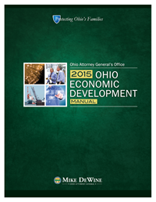
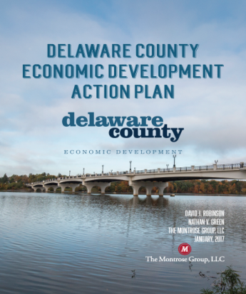
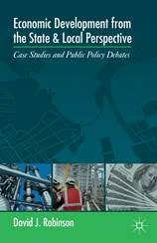
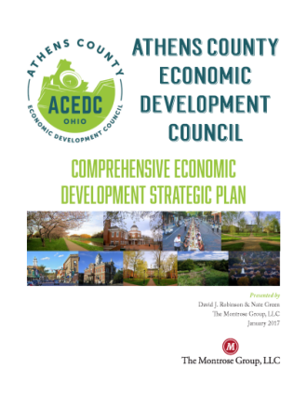

Montrose Group COVID 19 Economic Recovery Strategy
Montrose Group, LLC Wrote the Book on Economic Development

Slide 4
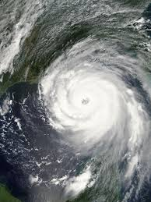
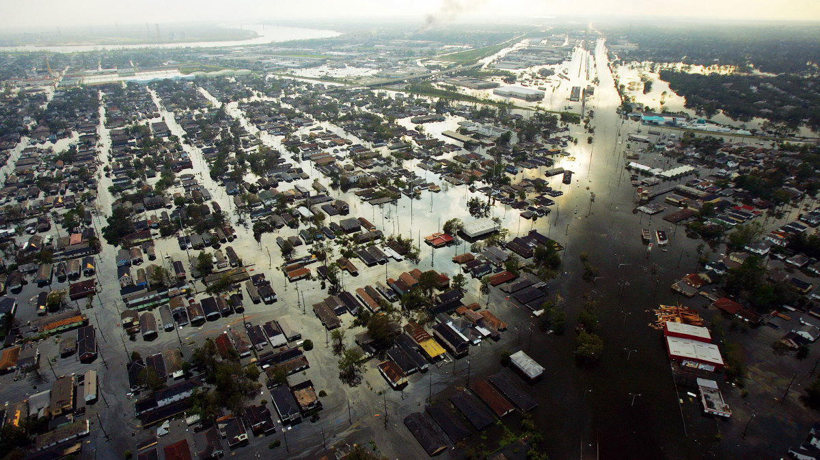

Montrose Group COVID 19 Economic Recovery Strategy

Slide 5
Montrose Group COVID 19 Economic Recovery Strategy
Assess Economic Damage
Emsi Data dive to measure the before, during and after of the disaster's impact on the region's economy, workforce and employer base
Emsi Job Postings Analytics
Emsi Input-Output Model
Emsi Skill Shape Analysis for Upskilling Opportunities
Emsi Supply Chain Analysis
Business Development
Company Triage & Concierge Role
Post-COVID 19 industry target marketing strategy
Site Development Plans
Build PPPs with local, state & federal funding
Economic Development Planning
Public Infrastructure for Projects
Community Centers
Housing Rehabilitation
Revolving Loan Funds
Workforce Development
Rural Broadband Service

Slide 6
Montrose Group COVID 19 Economic Recovery Strategy
Assess COVID 19 Economic Impact
10M Americans filed for unemployment the last two weeks of March, 2020
US restaurants report in March laying off 3 M workers & losing sales of $25 B
JPMorgan estimates the Q1 2020 world economy GDP will decline 12%
St. Louis Federal Reserve estimates COVID 19
Could cost 47 M jobs
Increase the unemployment rate past 32%
Put at risk 67 M American jobs
Moody Analytics estimates a 29% GDP Decline

Slide 7
Montrose Group COVID 19 Economic Recovery Strategy
Post-COVID 19 Industry Winners
E-Commerce
Logistics
Medical Equipment Manufacturers
PhRMA
Post-COVID 19 Industry Losers
Traditional brick & mortar retail
Airlines
Events
Hospitality

Slide 8
Montrose Group COVID 19 Economic Recovery Strategy
Land Use Entitlements
Tax Incentives
Joint Economic Development Districts
Zoning
Annexation
Easements
Tax Abatements
Tax Credits
Infrastructure Finance
Tax Increment Financing
Local and State Grants
School Compensation Agreements
School Compensation Agreements
Constructing Financing
Construction Material Sales Tax Exemption
Transportation Improvement Districts
Montrose Group
Site Development
Approach

Slide 9

Montrose Group COVID 19 Economic Recovery Strategy
Sample State Demographic Data Impacting Site Development

Slide 10
Montrose Group COVID 19 Economic Recovery Strategy

Slide 11
Montrose Group COVID 19 Economic Recovery Strategy

Slide 12
Montrose Group COVID 19 Economic Recovery Strategy
Samples of State Tax Incentive Programs Supporting Site Development
Ohio
Enterprise Zone Program
Community Reinvestment Area
Tennessee
Sales and use tax exemptions
Missouri
Real & personal property tax exemptions on substantial improvements with job creation
Up to 100% with school board approval, awarded by city or county
retail generally not eligible
Real property exemptions on substantial improvements and job creation
Up to 100% with school board approval, awarded by city or county
retail generally not eligible but residential is
Brownfield Remediation Program
redevelop contaminated commercial/industrial sites
creating 10 jobs or retaining 25 to clean hands company accepted in 'Voluntary Cleanup Program"
Remediation Tax Credits may be used for up to 100% of the cost to remediate the project property
Oregon
Manufacturing machinery and utilities, corporate headquarters, warehouse and distribution facilities, call centers, data centers, and for research and development facilities
Enterprise Zone Program
Fasttrack Economic Development Fund
Closing Fund
Grants to local governments and then reimbursed to companies
Funds retrofitting of buildings, acquiring real property, relocation of equipment, and other expenditures not covered under other Fasttrack programs.
Exempts businesses from local property taxes on new investments
Sponsored, created, and managed by a local government in 74 EZ Zones
100% property tax exemption from normally assess on a new plant and equipment for non-retail businesses' location or expansion for a period of three to five consecutive years
Qualified property includes new building structures, structural modifications, newly installed machinery but not land or previously used property
Business must
Increase full-time employment inside the Zone by the greater of one new job or 10%
Have no concurrent job loss outside the Zone
Maintain minimum employment during the exemption
Engage in job-training as well as conform to any local conditions
Enhanced Enterprise Zone Program
State income tax credits for 5 years and local real property tax abatement of 50% for 10 years if:
Located in approved zone
Approved business clusters
New or expanded business creating or maintaining 2 new employees and $100,000 new, or
Provides health insurance and pay at least 50% of the premium
Replacement business creating or maintaining 2 new employees and $1,000,000 new investment

Slide 13
Montrose Group COVID 19 Economic Recovery Strategy
Samples of State Data Center Incentives Supporting Site Development
Missouri
Data Center Sales Tax Exemption Program
Ohio
Data Center Sales Tax Exemption
Sales and utility tax exemption on data center construction
Creates 10 new jobs paying average wages 150% of the county average wage, invests $25 M within 36 months
15 years of state and local sales tax exemptions
Existing data centers eligible for a 10-year exemption if creating at least 5 new jobs within 24 months, paying 150% of the county average way, and investing $5 million within a year
Full or partial abatement from state and local sales tax on purchases of eligible data center equipment totaling at least $100 million and creating an annual payroll of $1.5 million
Applies to multi-tenant data-centers allowing multiple customers at one site to aggregate their purchases and payrolls in order to qualify

Slide 14
Montrose Group COVID 19 Economic Recovery Strategy
Sample State TIF Laws Supporting Site Development
Missouri Local TIF
Ohio TIF
Tennessee TIF
Redevelop blighted areas by providing essential public infrastructure financing
Located in blighted or CBD
Underlying local TIF provides 50% of new, local sales tax revenue and 100% of new real property tax revenue
15 years for public works improvements
Gap financing with local TIF
Capture local property and sales tax increase for up to 23 years for redevelopment
Sites blighted, conservation, or economic development
Funds professional service studies, land surveys, land acquisition, demolition, rehabilitation, and building infrastructure
State Supplemental TIF
Townships, municipalities, and counties
Finance infrastructure improvements and, limitedly, residential rehabilitation associated with new development
Pauses the taxable worth of real property within a specified area and redirects tax payments over this amount (derived from increases in real property value) to a separate fund financing the infrastructure project
Cities and counties
Captures future tax revenues to pay for current community improvements
Supports blighted and deteriorated areas, industrial development, recreation, convention centers and tourism
Funds public infrastructure, utility service, professional development services, equipment costs
Economic impact plan
Oregon TIF
Cities with populations greater than 50,000 to use a portion of property taxes generated within the district to invest in the district's infrastructure, providing further incentive for private investment
Property value increase invested in TIF district funding
Might also be used to retain businesses as well as to attract new entities

Slide 15
Montrose Group COVID 19 Economic Recovery Strategy
State Infrastructure Grants Supporting Site Development
Missouri
Infrastructure Development Opportunities Commission Program
Ohio
Roadwork Development 629 Grants
Tennessee Fasttrack Infrastructure Program
Provides local political subdivisions, including public sewer and water districts, with long-term, 3% interest rate loans between $25,000 and $150,000
Help rural communities and districts
Loans fund infrastructure improvements prioritizing water, sewer, and safety issues
Reimbursable public infrastructure funding to local governments, port authorities, and companies
Manufacturing, high-tech, corporate headquarters, and distribution activity
Cover engineering, design costs, actual construction of roadways and/or utility improvements
Tennessee
Grants for local governing bodies for public infrastructure
Companies creating jobs or making capital investments and must include a local match based on
Eligible projects include those affecting rail, public roadways, ports, airports, water, sewer, and gas
Grants determined by the number of full-time jobs, amount of company investment, location of the project (at-risk counties 35% premium and distressed counties 50% premium), average wage of new jobs, and other factors
Oregon
Oregon Regional Infrastructure Fund
Local government grants
Eligible project supports growth, addresses a regional priority, supports job creation and retention, does not rely upon continuing subsidies, and is ready for implementation upon approval
Business Investment Program
“Traded-sector" businesses, such as manufacturing firms
Project must receive local government incentives or be in a pre-approved Strategic Investment Zone
15-year exemption is on project property greater than $100 M in metro and $25M elsewhere
Community service fee of 25% of tax savings is paid each year to local governments
Projects include capital spending, and technology, research and workforce investments

Slide 16
Montrose Group COVID 19 Economic Recovery Strategy
Rickenbacker
Global
Logistics
Park &
Beyond

Slide 17
Montrose Group COVID 19 Economic Recovery Strategy

Slide 18
Montrose Group COVID 19 Economic Recovery Strategy
State Government COVID 19 Business Recovery Program Highlights
California $1 B Loan Business Loan Programs
JobsOhio $200M Loan Fund, Port Financing, Loan Guarantees
Arkansas $12M CDBG Program
Oregon
Arizona $50M Coronavirus Relief Fund
Small Business Loan Modifications and Forgiveness defers payments and interest
"Small Business Stabilization Fund" $700,000 as leverage for funding from others
Florida $50 Emergency Bridge Loan Program

Slide 19
Montrose Group COVID 19 Economic Recovery Strategy
Source: Investment Strategy Group, Committee for a Responsible Federal Budget

Slide 20
Small Business Administration (SBA)
SBA Economic Injury Disaster Loans (EIDL)
Covid19relief.sba.gov
Up to $2M loan or working capital
$10,000 grant within 3 days of applying
Pay for operational costs like payroll, rent, utilities, debt payments
EIDL Eligibility
In business since 1/31/2020
500 or fewer employees
Sole proprietorships with or without employees
Independent contractors
Cooperatives and employee owned businesses
Tribal small businesses

Slide 21
Small Business Administration (SBA)
SBA Paycheck Protection Program (PPP)
Apply through local SBA lender (e.g. bank)
Interim Final Rule sent late April 2, 2020
Loans of 2.5x Average Monthly Payroll – Max $10 M
1.0% interest
Loan payments deferred for 6 months
100% loan guarantee
Funds spent on payroll, interest, rent, & utilities are forgiven

Slide 22
Small Business Administration (SBA)
SBA Debt Relief
SBA to make 6 months of loan payments on behalf of borrowers with existing 7(a) loans (including Community Advantage) 504 loans Microloans

Slide 23
Federal Reserve
Primary Market Corporate Credit Facility (PMCCF) Direct Lending Funding
$500B
PMCCF Direct Lending
$25B for passenger air carriers
$4B for cargo air carriers
$17B for businesses important to maintaining national security.
$304B to other businesses
$150B to local and state governments through block grants
Allows the Fed to lend directly to corporations by buying new bond issuances and providing loans

Slide 24
Federal Reserve
PMCCF Direct Lending Targets
Nonprofit organizations and businesses
Between 500 and 10,000 employees
Loan must retain at least 90% of the recipient’s workforce through September 30, 2020
Will not outsource or offshore jobs for the term of the loan plus 2 years
Cannot increase the compensation of any officer or employee whose total compensation exceeds $425,000,
Prohibited from having officers or employees making over $3M last year plus fifty percent of the amount their compensation last year exceeded $3M

Slide 25
US Economic Development Administration (EDA)
Economic Adjustment Assistance (EAA) Program
Funds technical, planning, and public works and infrastructure assistance
Regions experiencing adverse economic changes that occur suddenly or over time
$1.5B in supplemental funding for the Economic Adjustment Assistance program

Slide 26
US Economic Development Administration (EDA)
EAA Strategy Grants
Development, updating or refinement of a Comprehensive Economic Development Strategy (CEDS)
CEDS is a prerequisite for qualifying for EDA funds for projects
COVID 19 may require a CEDS update
COVID 19 may permit a CEDS creation to craft a disaster recovery strategy

Slide 27
US Economic Development Administration (EDA)
EAA Implementation Grants
Execution of CEDS strategy
Infrastructure improvements
Site acquisition
Site preparation
Construction
Rehabilitation
Equipping of facilities
EAA Implementation Grants
Market and environmental studies
Planning or construction grants
Seed or replenish revolving loan funds

Slide 28
US Economic Development Administration (EDA)
EAA Case Study
Industrial Park Development
Site location and acquisition cost
Industry research focus
Infrastructure costs
Remediation costs
Construction budget
EAA Case Study
Revolving Loan Fund
Identification of business access to capital gap
Corporate organization of revolving loan fund
Revolving Loan Fund Board of Directors
Revolving Loan Fund seed capital and EDA match
Revolving Loan Fund loan terms and agreements
Revolving Loan Fund marketing

Slide 29
Community Development Block Grant (CDBG)
Federal Stimulus & CDBG
$5B in COVID 19 federal stimulus funding
$2B distributed by 2020 allocation to large cities and states
$1B distributed to states in 45 days to combat COVID 19
$2B distributed to states for longer term economic and housing disruptions

Slide 30
Community Development Block Grant (CDBG)
CDBG Funds
Infrastructure
Economic development projects
Public facilities installations
Community centers
Housing rehabilitation
Public services
Microenterprise assistance
CDBG Funds
Fund up to 50% of total project costs, not to exceed $500,000
Up to $10,000 can be granted or $25k-$35k loaned for every full-time equivalent job created or retained as a result of the project
Public infrastructure projects (e.g., water, sewer, roads) are eligible for up to 50% CDBG grant funding, not to exceed $500,000, towards project
Private, for-profit projects can qualify for up to 50% CDBG low-interest loans, not to exceed $500,000 towards project

Slide 31
Community Development Block Grant (CDBG)
CDBG Key Criteria
Employing at least 51% low- to moderate-income persons
Eliminating slum and blight
Meet an “urgent” need

Slide 32
Community Development Block Grant (CDBG)
Missouri HUD Allocations – Round 1 Federal Stimulus
$13.6M Statewide Nonentitlement Areas
$10.8M City of St. Louis
$3.3M St. Louis County
$646K St. Charles County
$2.2M across additional entitlement communities
$726K Jefferson County
$4.6M City of Kansas City
$936K St. Joseph
$916K Springfield

Slide 33
Community Development Block Grant (CDBG)
CDBG COVID 19 Recovery Services
Buildings and improvements
Public facilities, for testing, diagnosis or treatment demands
Rehabilitating a commercial building or closed school building to be converted into infectious disease facilities
Special Economic Development Assistance
Grants or loans to support new businesses and business expansion that creates jobs and manufactures medical supplies necessary to the infectious disease response
To avoid job loss caused by business closures related to social distancing by providing short-term working capital assistance that retains jobs held by low- and moderate-income persons
Microenterprise assistance for technical assistance, grants, loans and other financial assistance to establish, stabilize, and expand microenterprises that provide medical, food deliver, cleaning, and other services to support home health quarantine

Slide 34
Community Development Block Grant (CDBG)
CDBG Case Study
Local CDBG Revolving Loan Fund
Identification of business access to capital “gap” & CDBG loan need
State grants money to community to issue loan = seed capital
Revolving Loan Fund Board of Directors
Revolving Loan Fund loan terms and agreements
Revolving Loan Fund marketing
Corporate organization of revolving loan fund

Slide 35
USDA Rural Development
Federal Stimulus & USDA Rural Development
$48.9 B to USDA – Close the “digital divide” in America’s rural communities
$145 M USDA’s Rural Development programs
$20.5 M for the Rural Business-Cooperative Service, adding $1 B in lending authority
$100 M in grants for Rural Broadband Service
$25 M for Distance Learning and Telemedicine Programs

Slide 36
USDA Rural Development
Rural Development Broadband ReConnect Loan and Grant Program
Loans and grants
Construction, improvement, or acquisition of facilities and equipment needed to provide broadband service in eligible rural areas that do not have access to at least 10 Mbps downstream and 1 Mbps upstream
100% Grant – up to $25,000,000 max grant request
50% Loan / 50% Grant – up to $25,000,000 loan and $25,000,000 grant request and loan/grant requests will always be equal
100% Loan – up to $50,000,000 max loan request
Eligible Applicants
Cooperatives, non-profits, or mutual associations, for-profit corporations, state or local governments, territory or an Indian tribe

Slide 37
USDA Rural Development
USDA DLT Case Studies
DLT 100% Grants
15% match from the applicant
Award range: $50,000 - $1,000,000
Eligible uses: acquisition of eligible capital assets (broadband transmission facilities; audio, video and interactive video equipment; terminal and data equipment; computer hardware, network components and software; inside wiring and similar infrastructure that further DLT services); acquisition of instructional programming for eligible equipment; acquisition of technical assistance and instruction for using eligible equipment
USDA Rural Broadband Case Study
Logan Telephone Cooperative Inc. received a $34.4 M USDA Telecommunications Program loan to upgrade a FTTH system in Butler, Logan and Muhlenberg counties in southwestern Kentucky
Morton County, N.D., USDA is partnering with BEK Communications Cooperative to provide an $844,000 Community Connect Program grant for a 49-mile Fiber-to-the-Home network will bring high-speed broadband to 125 underserved households
SW Virginia, iGo Technology Inc. received a $3 M Community Connect grant to bring enhanced broadband opportunities to 820 homes and businesses giving the Bee Community Center, in the town of Bee in Dickenson County, free broadband for two years
Owensboro Health Inc. received $460,820 grant to install telemedicine equipment at 10 sites in Kentucky and Indiana. The equipment expands health care resources to ~35,000 residents, including ~2,000 patients.
USDA Distance Learning and Telemedicine Program
Education or health care through telecommunications
State and local government entities, federally-recognized Tribes, non-profits, for-profit businesses, and consortias are eligible
Lisbon (OH) Exempted Village School District received $323,478 to create distance learning network at 8 sites in Columbiana County. District is offering classes and behavioral health services to 850 students.

Slide 38
Montrose Group COVID 19 Economic Recovery Strategy
Conclusions
Thoughts
Questions
Contact
drobinson@montrosegroupllc.com
ngreen@montrosegroupllc.com
jbgrant@montrosegroupllc.com
tbiggam@montrosegroupllc.com

