Slide 1

Making Revolving Loan Funds Work for your Community
Dave robinson
Nate green
Tim biggam
Jamie beier grant
April 24, 2020

Slide 2

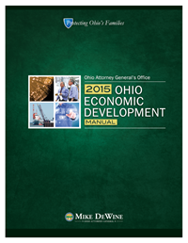
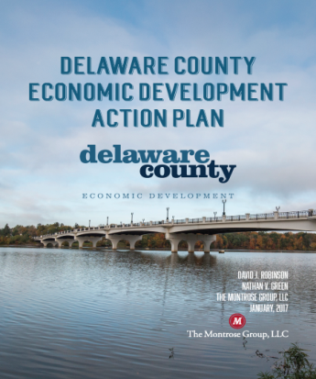
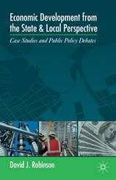
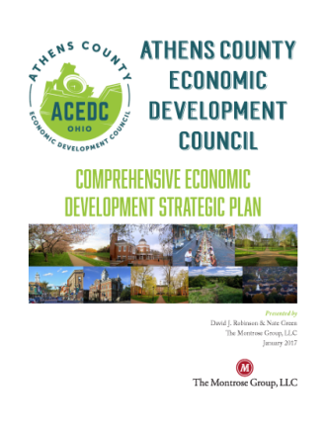

MONTROSE GROUP COVID 19 ECONOMIC RECOVERY STRATEGY
Montrose Group, LLC Wrote the Book on Economic Development

Slide 3
MONTROSE GROUP COVID 19 ECONOMIC RECOVERY STRATEGY
ROLE OF ECONOMIC DEVELOPERS IN COVID 19 ECONOMIC RECOVERY
Economic Developers & COVID 19 Recovery
What to expect?
How to prepare?
What should we ask our companies?
How will tax incentives be impacted?

Slide 4
MONTROSE GROUP COVID 19 ECONOMIC RECOVERY STRATEGY
COVID 19 National Economic Impact
  Federal Reserve found manufacturing output decreased 6.3% from the prior month
  US restaurants report in March laying off 3 M workers & losing sales of $25 B
  St. Louis Federal Reserve estimates COVID 19
    Increase the unemployment rate past 32%
  IMF predicts US GDP will shrink 5.9% in 2020
  Retail sales plunged 8.7% in March
    Car sales dropped 25.6 %
    Clothing sales fell 50.5 %
    Grocery sales increased 26%
    Non-store retail increased 3.1%

Slide 5
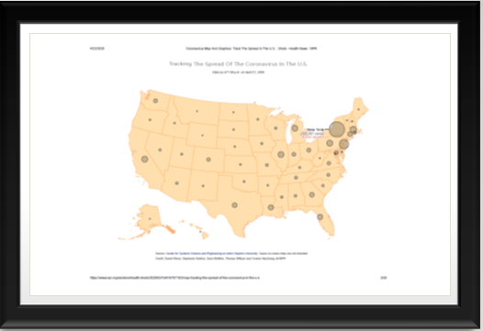
MONTROSE GROUP COVID 19 ECONOMIC RECOVERY STRATEGY
COVID 19 REGIONAL CASES BY COMPARISON – Where the “hot spots” are

Slide 6
MONTROSE GROUP COVID 19 ECONOMIC RECOVERY STRATEGY

Slide 7
MONTROSE GROUP COVID 19 ECONOMIC RECOVERY STRATEGY
Life & Limb
Economic Survival
Return to Work
Carpe Diem
Stages of COVID 19 from Economic Developer’s View

Slide 8
MONTROSE GROUP COVID 19 ECONOMIC RECOVERY STRATEGY
Factors Impacting Company Reopening Decisions
Depth of Market Disruption
Preparation of workplace
Length of Market Disruption
Increase or decline of COVID 19 cases
Shape of Market Recovery
Integration of data driven public health policy with private sector economic activation
COVID 19 cases at company
Location of company COVID 19 cases
Customer market demand
Hospital preparedness
Availability of therapies
Late customer payments
Access to capital
Availability of rapid testing technology for health care providers and companies
Re-establishment of consumer confidence
Impact of on-going public health regulations

Slide 9
MONTROSE GROUP COVID 19 ECONOMIC RECOVERY STRATEGY
ROLE OF ECONOMIC DEVELOPERS IN COVID 19 ECONOMIC RECOVERY
Economic Survival
Assess Economic Damage
Gaining Workforce for COVID 19 Supply Chain
Keeping Companies Alive
Build Regional Financing Mechanisms
Tax Incentive Flexibility

Slide 10
MONTROSE GROUP COVID 19 ECONOMIC RECOVERY STRATEGY
Land Use Entitlements
Tax Incentives
Joint Economic Development Districts
Zoning
Annexation
Easements
Tax Abatements
Tax Credits
Infrastructure Finance
Tax Increment Financing
Local and State Grants
School Compensation Agreements
School Compensation Agreements
Constructing Financing
Construction Material Sales Tax Exemption
Transportation Improvement Districts
Montrose Group
Site Development
Approach

Slide 11
MONTROSE GROUP COVID 19 ECONOMIC RECOVERY STRATEGY
Source: Investment Strategy Group, Committee for a Responsible Federal Budget

Slide 12
MONTROSE GROUP COVID 19 ECONOMIC RECOVERY STRATEGY
Federal Stimulus “3.5” Overview
$321 B replenishing Paycheck Protection Program
$484 B in COVID 19 federal stimulus “3.5” funding
$60 B in additional SBA EIDL funding for loans ($50 B) and grants ($10 B)
$75 B for hospitals to cover increased expenses and lost revenue
$60 B set aside for underbanked businesses
$25 B for COVID 19 testing, of which $11 B will go to states and federal government to develop, purchase, administer, process and analyze tests
$150 B request for state and local government aid not included
$1 B to Centers for Disease Control and Prevention
$1.8 B to National Institutes of Health
$22 M to the FDA
$825 M for community health centers and rural health clinics
Up to $1 B to cover testing for uninsured
$6 M to HHS inspector general’s office to bolster oversight activities

Slide 13
MONTROSE GROUP COVID 19 ECONOMIC RECOVERY STRATEGY
JobsOhio Community Bank Loan Guarantee Program
$50 M in lending support to companies negatively affected by COVID 19
Partnership with Peoples Bank and First Federal/Home Savings Bank
Support to small business clients with maintaining operations and payroll
Existing business clients with loans or lines of credit of <$1 M as of February 29, 2020 are eligible
Peoples Bank
New loans up to 20% of existing loans or lines of credit, not to exceed $200k
Business deposit only clients eligible for new loan up to 10% of annual gross revenue, not to exceed $100k
Loan Terms – 66 months with interest only for first 6 months; unsecured loan; no origination fees

Slide 14
MONTROSE GROUP COVID 19 ECONOMIC RECOVERY STRATEGY
JobsOhio Community Bank Loan Guarantee Program
First Federal Bank/Home Savings
Eligible use of funds – working capital, including payroll, rent, mortgages or other fixed debts, utilities and other bills
Maximum loan of $200k
Current borrowers eligible for the lower of 20% of total existing commitments or max of an additional $200k
Loan Terms – 35 month loan; 6 months interest only; 29 principle and interest months using a 60-month amortization
Ohio based businesses and current bank loan or deposit customers in good standing are eligible
Variable rate loan at prime rate, currently 3.25%
Deposit only customers eligible for lower of 10% of aggregate annual revenues from sales (most recent 12 month period) or $100k

Slide 15


MAKING REVOLVING LOAN FUNDS WORK FOR YOUR COMMUNITY
Small Businesses Drive Our Economies
Small Business Administration (SBA’s) Definition
65%
NET NEW JOBS
500
Small businesses account for 65% of net new jobs. (2000-2018)
47.5% of all private sector employees
40.7% of private sector payroll
400K Small Business Closures vs. 433K Startups = 33K Net New Startups
  Startup defined as being <1 year old
…or small business?
Source: U.S. Small Business Administration

Slide 16
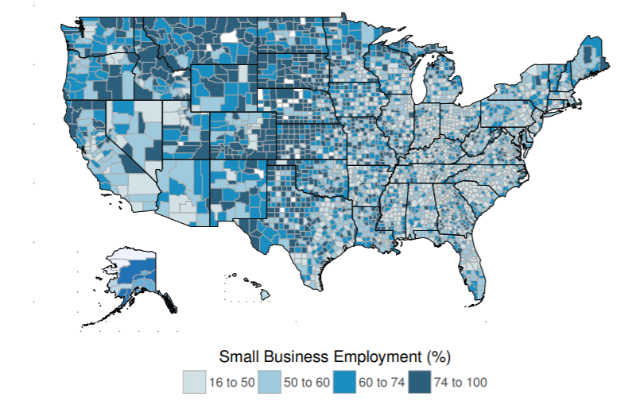
MAKING REVOLVING LOAN FUNDS WORK FOR YOUR COMMUNITY
Small Businesses Drive Our Economies
Source: U.S. Small Business Administration

Slide 17
MAKING REVOLVING LOAN FUNDS WORK FOR YOUR COMMUNITY
Small Business Impact in the COVID 19 Environment
National Small Business Association conducted a COVID 19 Small Business Survey in early April
  980 Respondents
  92% very concerned about the economic impact of COVID 19
  Eighty percent have experienced reduced customer demand, up from 49 percent just four weeks ago
  Two-thirds of small business owners anticipate a recession in the next 12 months vs. 14% in January
  Nearly half of small businesses are not confident in the future of their business
  53% of respondents are concerned about a possible second-wave of COVID 19 and its long-term impact on their business

Slide 18
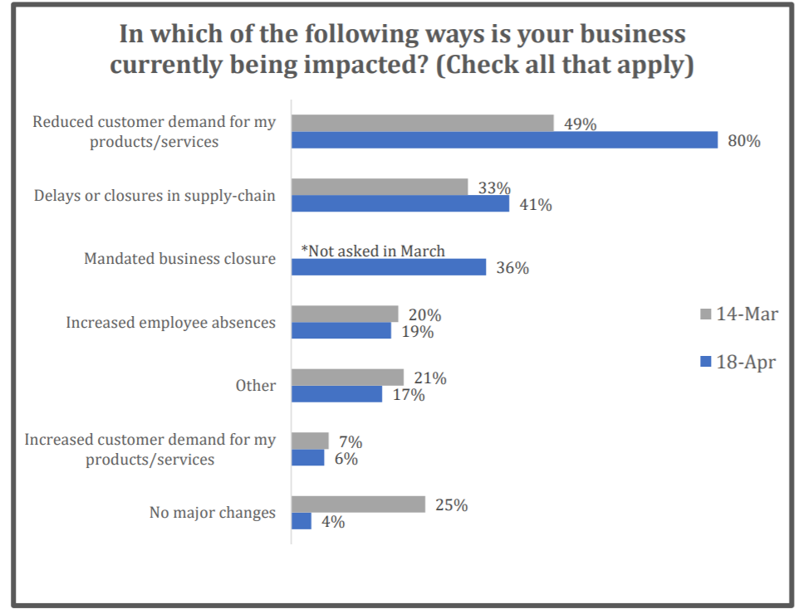
MAKING REVOLVING LOAN FUNDS WORK FOR YOUR COMMUNITY
COVID 19 Small Business Impacts
Source: National Small Business Association

Slide 19
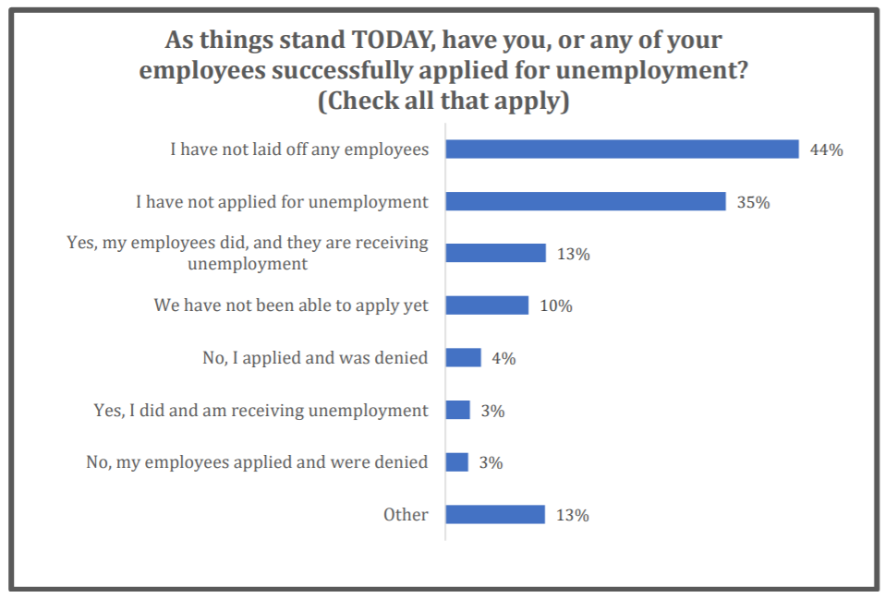
MAKING REVOLVING LOAN FUNDS WORK FOR YOUR COMMUNITY
COVID 19 Small Business Impacts
Source: National Small Business Association

Slide 20
MAKING REVOLVING LOAN FUNDS WORK FOR YOUR COMMUNITY
Working Capital
· establishes operational liquidity
Business Mentoring
· opportunities for ongoing operational support & long-term success
Alternative Financing Support
1. “Close the Gap”
2. Sharing in equity
contributions
Support to Drive Small Business Growth
Flexible and integrated support systems create an ecosystem where small businesses thrive and survive

Slide 21
MAKING REVOLVING LOAN FUNDS WORK FOR YOUR COMMUNITY
Access to Capital for Small Businesses
Government Funds
(Federal, State, Local)
Mission Related Capital
(EDOs, Foundations)
Traditional Lenders
Lower cost financing
Typically accompanied by specific requirements (Davis Bacon wages, environmental review, historical preservation clearances, etc.)
Typically secured by grant-writing/RFP process
Establishes track record for future community requests
Affordable financing
Uses of funds aligned with specific organizational purposes (ED organizations, Chamber of Commerce, etc.)
Gap financing mechanism
Flexible rates and terms
Subordinated debt
Capital costs may be higher
Established business track record typically a prerequisite (3 yrs. in operation)
Equity requirements can be up to 20%
Access to SBA 7(a) and other loan programs
Project requirements are typically minimal

Slide 22
MAKING REVOLVING LOAN FUNDS WORK FOR YOUR COMMUNITY
Mission Related Capital – Small Business Lending Program Ideas
Gap Financing – for more established businesses
Micro Loans – for new and emerging businesses
Credit Building Loans – small loan amounts to help entrepreneurs or credit-deficient owners build credit and ability to access conventional financing
Transactional Financing Loans – for small contractors that need assistance with securing inventory and M&E for project bidding and construction
Consulting or Advisory Loans – for small businesses needing professional services to bring projects to fruition
Loan Guarantees – to back conventional lender financing
Seed/Venture Capital - % of overall loan program income dedicated to seed money

Slide 23
MAKING REVOLVING LOAN FUNDS WORK FOR YOUR COMMUNITY
Components to a Revolving Loan Fund Program
RLF programs are typically geared towards some form of “gap financing” for small businesses that struggle to secure funding through conventional bank financing routes (% Equity + % Conventional Loan = 100% of Project Need)
RLFs create a self-replenishing pot of money for use on future mission-driven small business and economic development priorities
  P&I replenishes the pot and new loans are issued
The administering RLF organization, with input and support form stakeholders, determines the industry sectors eligible for funding and the types of activities that are eligible uses of loan funds
RLFs typically take a subordinated position to conventional lender – reducing lender risk while supporting small business development and entrepreneurial activity

Slide 24
MAKING REVOLVING LOAN FUNDS WORK FOR YOUR COMMUNITY
Structuring a Revolving Loan Fund Program
Identify administering organization – governmental body, Economic Development Organization, Chamber of Commerce, etc.
Establish a Revolving Loan Fund Board
  Who are financial experts in your community?
  Who are business development stakeholders in the community?
Establish program criteria and loan procedures
  Maximum lending limits; Job creation or retention requirements; Equity requirement; Limited rates and/or terms
Establish loan procedures
  Application process and required documentation (business plan, business/personal tax returns, PFS, borrowing agreement, proof of incorporation, financial projections, cost estimates, etc.)
  Drafting of loan and legal documents (an attorney is your best bet)
  How will loan be serviced/monitored?

Slide 25
MAKING REVOLVING LOAN FUNDS WORK FOR YOUR COMMUNITY
Seeding a Revolving Loan Fund Program
Local Banks
Community Foundations
Utility Companies
Public Funding Programs (CDBG, EDA, USDA)
EDOs, Chambers of Commerce

Slide 26

MAKING REVOLVING LOAN FUNDS WORK FOR YOUR COMMUNITY
Marketing a Revolving Loan Fund Program
Greg Myers, MS, EDFP
Executive Director
Ashtabula Growth Partnership
35 West Jefferson St.
Jefferson, OH 44047
greg@ashtabulagrowth.com

Slide 27
MAKING REVOLVING LOAN FUNDS WORK FOR YOUR COMMUNITY
Marketing a Revolving Loan Fund Program
Marketing the RLF Purpose – it’s not a “One Size Fits All” loan program
    RLFs should not be a first source of financing; RLFs should play supportive role
Identify the Audience – who are possible applicants and how do you reach them with messaging?
Increase Bandwidth - utilize stakeholders within the organization and community to help identify possible applicants
    Board Members, Banks, Credit Unions, Chambers of Commerce, Elected Officials
Create Relevance - establish your organization as a resource for the target audience
Develop Marketing Outreach – social media, marketing materials, receptions with stakeholders

Slide 28
MAKING REVOLVING LOAN FUNDS WORK FOR YOUR COMMUNITY
Revolving Loan Fund Programs Vary by State or Group
Wisconsin
Communities with fewer than 50,000 residents are eligible for state CDBG ED loan funds
Maximum $1 M in loans
State sets Loan to Value rations of activities being financed
$35k per job
Loan repayment max is 5 years
Minnesota
Assistance to businesses for traditional fixed asset investments, but also rail spurs and downtown commercial rehabilitation
Business Incubators – to develop or rehab property for incubator use; provide assistance to businesses locating in incubator space
Job Training – skills building of unskilled, low-income persons; retraining of existing employees

Slide 29
MAKING REVOLVING LOAN FUNDS WORK FOR YOUR COMMUNITY
Revolving Loan Fund Programs Vary by State or Group
Salt Lake City, UT
Startup and existing businesses or revenue producing non-profit ventures
Working capital and marketing
Energy efficient equipment upgrades and building retrofits
Signage, retail presentation and display work
Startups eligible for up to $100k
Existing businesses up to $350k
Microloans are $25k or less
Loan Terms are 6 months to 7 years
Maximum Rate is Prime + *%
Support city goals of development in geographic priority areas, LMI owners, Veteran owners, Disabled owners, Green businesses
Delaware
True Access Capital formed out of community stakeholder vision to better support Delaware/Southern PA region
Micro Loan Program – start-up and expansion projects; $5k to $50k; working capital, inventory, M&E
Community Development Loan Fund – non-profit and for-profit community-based projects (childcare centers, community centers, mixed use properties); max loan is $150k

Slide 30
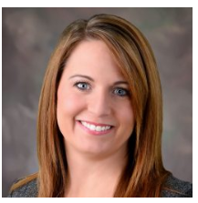

MAKING REVOLVING LOAN FUNDS WORK FOR YOUR COMMUNITY
Athens County, OH Small Business Lending Tools
Sara Marrs-Maxfield, CEcD, EDFP
Executive Director
Athens County Economic Development Council
Athens County Port Authority
340 West State Street, unit 26
Athens, Ohio 45701
(740) 597-1420
www.athenscountyohedc.com

Slide 31

MAKING REVOLVING LOAN FUNDS WORK FOR YOUR COMMUNITY
Athens County Revolving Loan Fund Programs
Community Development Block Grant RLF (CDBG RLF)
CDBG funded (Federal Funding funneled through the State of Ohio
Nature of federal funding makes the program somewhat inflexible
  Federal Davis Bacon prevailing wage rates on construction, renovations, M&E installation
Job creation/retention requirements (annual documentation required)
  1 FTE created or retained per $25k loaned
Maximum 50% funding of total project (must have other lender participation)
Specified eligible and ineligible activities
Owner equity requirement
Competitive interest rates; subordinated debt position

Slide 32
MAKING REVOLVING LOAN FUNDS WORK FOR YOUR COMMUNITY
Athens County Revolving Loan Fund Programs
COVID 19 Related CDBG Program Adjustments
Existing loan rates and terms may be modified with approval of the local RLF board
  Rates may be reduced to 0 percent, terms may be modified, and 6-12 months P&I deferrals are allowed
CDBG RLFs may approve new loans at 0 percent interest with 6-12 months P&I deferrals
  Ohio’s Office of Community Development approval is required for new loans
The 30% program income cap on working capital loans has been removed
  RLFs may exceed 30 percent of program income to make working capital loans
  Working capital loans no longer need to be accompanied by fixed asset investment

Slide 33
MAKING REVOLVING LOAN FUNDS WORK FOR YOUR COMMUNITY
Athens County Revolving Loan Fund Programs
Small Business Micro Loan Fund
In August 2015, the Athens County Economic Development Council received a $150,000 USDA rural business development grant (RBDG) to establish a small business micro-loan fund aimed at assisting and encouraging development in the rural business sector of Athens County.
Goals
Encourage expansion/stability of Athens County economic base
Encourage increased employment opportunities for Athens residents
Encourage establishment and expansion of locally owned businesses
Eligibility
Eligible activities include – provision of financial assistance to private, for-profit entities that create, expand or retail particular rural businesses
Financing may include – fixed assets, buildings/facilities, leasehold improvements, machinery/equipment, infrastructure investment and working capital

Slide 34
MAKING REVOLVING LOAN FUNDS WORK FOR YOUR COMMUNITY
Athens County Revolving Loan Fund Programs
Small Business Micro Loan Fund
Loan Terms and Amounts
Loans of $10,000 - $50,000 are available with at least 5% coming from a private source
Loan financing will not be offered for a term longer than the useful life of the asset(s) financed
Can be used as stand alone or partnered funding
Local control allows for more flexibility
Fees are low
Potential COVID 19 Adjustments
Inclusion of non-profits
Increase list of eligible activities to include – training, inventory, refinancing of existing debt

Slide 35
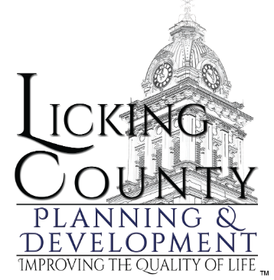
MAKING REVOLVING LOAN FUNDS WORK FOR YOUR COMMUNITY
Licking County, OH Small Business Lending Tools
Jillian Flowers
Community Development Specialist
Licking County Planning & Development
20 South Second Street
Newark, OH 43055
(740) 670-5200

Slide 36
MAKING REVOLVING LOAN FUNDS WORK FOR YOUR COMMUNITY
Licking County, OH Small Business Lending Tools
Community Development Block Grant (CDBG) Community Development provides a flexible community development resource to address locally identified needs that are eligible CDBG activities and qualify under the national objective of Low- and Moderate-Income (LMI) Benefit or Elimination of Slum and Blight. Ohio's non-entitlement counties and cities are eligible to apply and can use the CDBG funds for housing rehabilitation, economic development and public works improvements. The program is divided into two components: the Formula Allocation Grants and the Neighborhood Revitalization Grants (NRG).
CDBG Public Infrastructure provides funding to ensure a safe and sanitary living environment through the provision of safe and reliable drinking water and proper disposal of sanitary waste in distressed communities with a low- and moderate-income population of at least 51 percent.
Examples include: ADA compliant restrooms, sidewalk access, community facilities, sewer relining projects, demolitions, backup generators for water wells.
Licking County is under the PY19 grant and has an allocation of $470,000
and six projects county-wide.

Slide 37
MAKING REVOLVING LOAN FUNDS WORK FOR YOUR COMMUNITY
Licking County, OH Small Business Lending Tools
Licking County has had grant programs since the 1980’s
Licking County’s EDRLF fund has certain criteria it must follow. When GROW Licking County CIC was formed, we allocated money to follow them.
For the purposes of our accounts right now, we have about $22,000.00 that was allocated for a project in Buckeye Lake two years ago, but we ended up not touching it.
It was designed to be used for community center ADA compliant bathrooms and providing short-term jobs to people in the area.
The State of Ohio wants grantees to exhaust these funds through the CDBG program. The funds have been allocated to projects that have some sort of payoff like liens etc.

Slide 38
MAKING REVOLVING LOAN FUNDS WORK FOR YOUR COMMUNITY
Licking County, OH Small Business Lending Tools
In an effort to assist Ohioans effected by the COVID-19 crisis, we are allowing CDBG Program grantees the option to amend a current grant to utilize Emergency Housing Assistance (EHA) in conjunction with the CHIP program guidance issued earlier. You may amend your PY 2018 and PY 2019 Allocation grants to do Emergency Home Repair and Emergency Housing Assistance (this can also include rent, mortgage and utility payments) as long as the grant deadline does not need to be extended. This is a public service activity, so you will need a waiver letter if you choose to exceed the 15% cap (15% of the total grant not including admin/Fair Housing).
***Communities must amend their current grant award to pursue this.
Licking County has decided to opt out of this option solely because we currently have a CHIP award that has plenty of dollars that we can expend.
Resources:
https://development.ohio.gov/businessservices.htm
https://development.ohio.gov/cs/cs_edl.htm

Slide 39
MAKING REVOLVING LOAN FUNDS WORK FOR YOUR COMMUNITY
Role of Economic Development in COVID 19 Economic Recovery
Educator
Economic Development Implementer
Economic Development Thought Leader
Policy Advocate
Problem Solver

Slide 40
MAKING REVOLVING LOAN FUNDS WORK FOR YOUR COMMUNITY
Conclusions
Thoughts
Questions
Contact
drobinson@montrosegroupllc.com
ngreen@montrosegroupllc.com
jbgrant@montrosegroupllc.com
tbiggam@montrosegroupllc.com

