Slide 1




maedc
Montrose Group
COVID 19 Economic Recovery Strategy
Dave Robinson
Nate Green
Tim Biggam
Jamie Beier Grant
Montrose Group, LLC

Slide 2
Montrose Group COVID 19 Economic Recovery Strategy
Mid America Economic Development Association

Slide 3
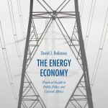
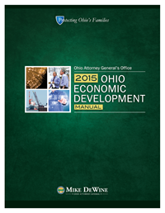
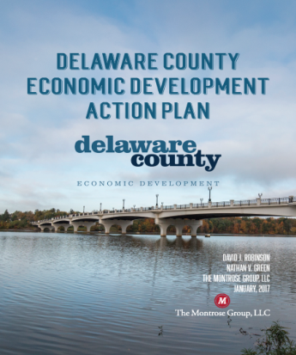
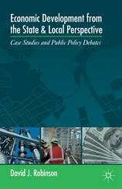
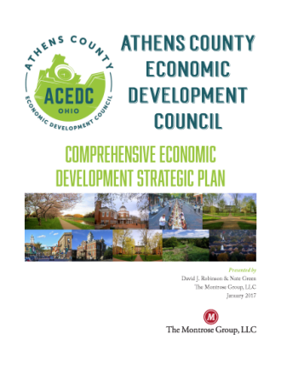
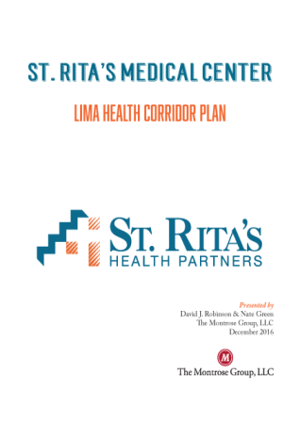

Montrose Group COVID 19 Economic Recovery Strategy
Montrose Group, LLC Wrote the Book on Economic Development

Slide 4
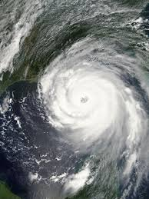
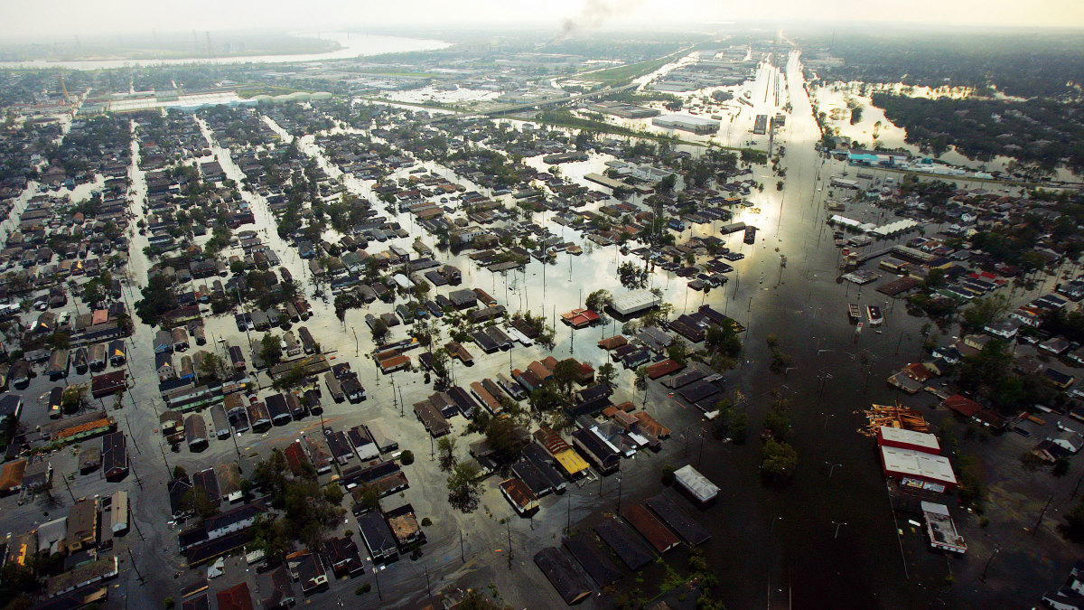

Montrose Group COVID 19 Economic Recovery Strategy

Slide 5
Montrose Group COVID 19 Economic Recovery Strategy
Assess Economic Damage
Emsi Data dive to measure the before, during and after of the disaster's impact on the region's economy, workforce and employer base
Emsi Job Postings Analytics
Emsi Input-Output Model
Emsi Skill Shape Analysis for Upskilling Opportunities
Emsi Supply Chain Analysis
Business Development
Company Triage & Concierge Role
Post-COVID 19 industry target marketing strategy
Site Development Plans
Build PPPs with local, state & federal funding
Economic Development Planning
Public Infrastructure for Projects
Community Centers
Housing Rehabilitation
Revolving Loan Funds
Workforce Development
Rural Broadband Service

Slide 6
Montrose Group COVID 19 Economic Recovery Strategy
Assess COVID 19 Economic Impact
US restaurants report in March laying off 3 M workers & losing sales of $25 B
Federal Reserve found manufacturing output decreased 6.3% from the prior month
St. Louis Federal Reserve estimates COVID 19
Increase the unemployment rate past 32%
IMF predicts US GDP will shrink 5.9% in 2020
Retail sales plunged 8.7% in March
Car sales dropped 25.6 %
Clothing sales fell 50.5 %
Grocery sales increased 26%
Non-store retail increased 3.1%

Slide 7
Montrose Group COVID 19 Economic Recovery Strategy
Post-COVID 19 Industry Winners
E-Commerce
Logistics
Medical Equipment Manufacturers
PhRMA
Post-COVID 19 Industry Losers
Traditional brick & mortar retail
Airlines
Events
Hospitality

Slide 8
Montrose Group COVID 19 Economic Recovery Strategy
Land Use Entitlements
Tax Incentives
Joint Economic Development Districts
Zoning
Annexation
Easements
Tax Abatements
Tax Credits
Infrastructure Finance
Tax Increment Financing
Local and State Grants
School Compensation Agreements
School Compensation Agreements
Constructing Financing
Construction Material Sales Tax Exemption
Transportation Improvement Districts
Montrose Group
Site Development
Approach

Slide 9
Montrose Group COVID 19 Economic Recovery Strategy
MAEDC REGION Demographic Data SNAPSHOT

Slide 10
Montrose Group COVID 19 Economic Recovery Strategy
MAEDC REGION Industry strength SNAPSHOT

Slide 11
Montrose Group COVID 19 Economic Recovery Strategy

Slide 12
Montrose Group COVID 19 Economic Recovery Strategy
State Government COVID 19 Business Recovery Program Highlights
California $1 B Loan Business Loan Programs
JobsOhio $200M Loan Fund, Port Financing, Loan Guarantees
Arkansas $12M CDBG Program
Oregon
Arizona $50M Coronavirus Relief Fund
Small Business Loan Modifications and Forgiveness defers payments and interest
"Small Business Stabilization Fund" $700,000 as leverage for funding from others
Florida $50 Emergency Bridge Loan Program

Slide 13
Montrose Group COVID 19 Economic Recovery Strategy
Source: Investment Strategy Group, Committee for a Responsible Federal Budget

Slide 14
US Economic Development Administration (EDA)
Economic Injury Disaster Loan Program (EIDL)
Covid19relief.sba.gov
Paycheck Protection Program (PPP)
Apply through local SBA lender (e.g. bank)
Up to $2M loan or working capital
$10,000 grant within 3 days of applying
Pay for operational costs like payroll, rent, utilities, debt payments
EIDL Eligibility
In business since 1/31/2020
500 or fewer employees
Sole proprietorships with or without employees
Independent contractors
Cooperatives and employee owned businesses
Tribal small businesses
Loans of 2.5x Average Monthly Payroll – Max $10 M
1.0% interest
Loan payments deferred for 6 months
100% loan guarantee
Funds spent on payroll, interest, rent, & utilities are forgiven
Interim Final Rule sent late April 2, 2020

Slide 15
Small Business Administration (SBA)
SBA Debt Relief
SBA to make 6 months of loan payments on behalf of borrowers with existing 7(a) loans (including Community Advantage) 504 loans Microloans

Slide 16
Federal Reserve
Primary Market Corporate Credit Facility (PMCCF) Direct Lending Funding
$500B
PMCCF Direct Lending
$25B for passenger air carriers
$4B for cargo air carriers
$17B for businesses important to maintaining national security.
$304B to other businesses
$150B to local and state governments through block grants
Allows the Fed to lend directly to corporations by buying new bond issuances and providing loans

Slide 17
Federal Reserve
PMCCF Direct Lending Targets
Nonprofit organizations and businesses
Between 500 and 10,000 employees
Loan must retain at least 90% of the recipient’s workforce through September 30, 2020
Will not outsource or offshore jobs for the term of the loan plus 2 years
Cannot increase the compensation of any officer or employee whose total compensation exceeds $425,000,
Prohibited from having officers or employees making over $3M last year plus fifty percent of the amount their compensation last year exceeded $3M

Slide 18
US Economic Development Administration (EDA)
Economic Adjustment Assistance (EAA) Program
Funds technical, planning, and public works and infrastructure assistance
Regions experiencing adverse economic changes that occur suddenly or over time
$1.5B in supplemental funding for the Economic Adjustment Assistance program

Slide 19
US Economic Development Administration (EDA)
EAA Strategy Grants
Development, updating or refinement of a Comprehensive Economic Development Strategy (CEDS)
CEDS is a prerequisite for qualifying for EDA funds for projects
COVID 19 may require a CEDS update
COVID 19 may permit a CEDS creation to craft a disaster recovery strategy

Slide 20
US Economic Development Administration (EDA)
EAA Implementation Grants
Execution of CEDS strategy
Infrastructure improvements
Site acquisition
Site preparation
Construction
Rehabilitation
Equipping of facilities
EAA Implementation Grants
Market and environmental studies
Planning or construction grants
Seed or replenish revolving loan funds

Slide 21
US Economic Development Administration (EDA)
2020 Economic Adjustment Assistance Award
Mississippi River Regional Planning Commission (LaCrosse/LaCrosse County, WI)
2020 EDA Public Works Award
$627K grant funding matched by $627K in local funds
Construction of new access road in industrial park to serve the Missouri Valley Joint Apprentice Training Center (JATC)
Apprenticeship programs to meet skilled workforce gap in electrical linesman profession
Supports higher paying employment opportunities & economic growth in region
Est. 3,465 jobs created to fill workforce gaps in region
$740,000 in Disaster Supplemental Award
Creation of an economic recovery and resiliency plan to mitigate future flooding and storm-related impacts
Study to analyze region’s safest sites for business, industry workforce housing, community facilitates and public infrastructure
Project will assist in targeting strategic areas for business CapEx and job creation

Slide 22
US Economic Development Administration (EDA)
EAA Case Study
Midwest Industrial Park Development
$2.7M EAA grant as part of $3.4M project; $1.7M funded by community
Construction of new roads, storm sewer, water, sewer, lighting conduit
Enhances transportation logistics
$900M private CapEx, 22 new jobs supported EAA request
EAA Revolving Loan Fund Program
Revolving Loan Fund
Identification of business access to capital gap
Corporate organization of revolving loan fund
Revolving Loan Fund Board of Directors
Revolving Loan Fund seed capital and EDA match
Revolving Loan Fund loan terms and agreements
Revolving Loan Fund marketing

Slide 23
Community Development Block Grant (CDBG)
Federal Stimulus & CDBG
$5B in COVID 19 federal stimulus funding
$2B distributed by 2020 allocation to large cities and states
$1B distributed to states in 45 days to combat COVID 19
$2B distributed to states for longer term economic and housing disruptions

Slide 24
Community Development Block Grant (CDBG)
CDBG Funds
Infrastructure
Economic development projects
Public facilities installations
Community centers
Housing rehabilitation
Public services
Microenterprise assistance
CDBG Funds
Typically funds up to 50% of total project costs
Loans and grants are made based on a certain $$ for every full-time equivalent job created or retained as a result of the project
Public infrastructure projects (e.g., water, sewer, roads) are eligible for up to 50% CDBG grant funding
Private, for-profit projects can qualify for up to 50% CDBG low-interest loans

Slide 25
Community Development Block Grant (CDBG)
CDBG Key Criteria
Employing at least 51% low- to moderate-income persons
Eliminating slum and blight
Meet an “urgent” need

Slide 26
Community Development Block Grant (CDBG)
City of Neodesha, KS CDBG + USDA
City Gas System Upgrades
Highland County Ohio CDBG RLF
Corvac Composites, LLC new automotive manufacturing facility sited in Highland COunty
$12.5M Total Project Cost
$500,000 CDBG RLF
$2.3M Total Project Cost
Public infrastructure upgrades to service 2,500 residents and businesses in community
$1.76M USDA Rural Development Grant
$600,000 CDBG Grant
$12M Outside Funding
Total Jobs Created – 55
29 LMI Jobs (52.7%) - $9,090/job created

Slide 27
Community Development Block Grant (CDBG)
CDBG Case Study
Local CDBG Revolving Loan Fund
Identification of business access to capital “gap” & CDBG loan need
State grants money to community to issue loan = seed capital
Revolving Loan Fund Board of Directors
Revolving Loan Fund loan terms and agreements
Revolving Loan Fund marketing
Corporate organization of revolving loan fund
Notes:
The Highland County CDBG RLF project is an example of how a private economic development project accessed state CDBG loan funds. In this instance, the state grants the funds to the county and the county then loans it to the company. Payments are made back to the county through a local CDBG RLF program which can be used to benefit other private sector investment projects needing gap financing assistance.

Slide 28
Community Development Block Grant (CDBG)
CDBG COVID 19 Recovery Services
Buildings and improvements
Public facilities, for testing, diagnosis or treatment demands
Rehabilitating a commercial building or closed school building to be converted into infectious disease facilities
Special Economic Development Assistance
Grants or loans to support new businesses and business expansion that creates jobs and manufactures medical supplies necessary to the infectious disease response
To avoid job loss caused by business closures related to social distancing by providing short-term working capital assistance that retains jobs held by low- and moderate-income persons
Microenterprise assistance for technical assistance, grants, loans and other financial assistance to establish, stabilize, and expand microenterprises that provide medical, food deliver, cleaning, and other services to support home health quarantine

Slide 29
USDA Rural Development
Federal Stimulus & USDA Rural Development
$48.9 B to USDA – Close the “digital divide” in America’s rural communities
$145 M USDA’s Rural Development programs
$20.5 M for the Rural Business-Cooperative Service, adding $1 B in lending authority
$100 M in grants for Rural Broadband Service
$25 M for Distance Learning and Telemedicine Programs

Slide 30
USDA Rural Development
Rural Development Broadband ReConnect Loan and Grant Program
Loans and grants
Construction, improvement, or acquisition of facilities and equipment needed to provide broadband service in eligible rural areas that do not have access to at least 10 Mbps downstream and 1 Mbps upstream
100% Grant – up to $25,000,000 max grant request
50% Loan / 50% Grant – up to $25,000,000 loan and $25,000,000 grant request and loan/grant requests will always be equal
100% Loan – up to $50,000,000 max loan request
Eligible Applicants
Cooperatives, non-profits, or mutual associations, for-profit corporations, state or local governments, territory or an Indian tribe

Slide 31
USDA Rural Development
USDA DLT Case Studies
DLT 100% Grants
15% match from the applicant
Award range: $50,000 - $1,000,000
Eligible uses: acquisition of eligible capital assets (broadband transmission facilities; audio, video and interactive video equipment; terminal and data equipment; computer hardware, network components and software; inside wiring and similar infrastructure that further DLT services); acquisition of instructional programming for eligible equipment; acquisition of technical assistance and instruction for using eligible equipment
USDA Rural Broadband Case Study
Logan Telephone Cooperative Inc. received a $34.4 M USDA Telecommunications Program loan to upgrade a FTTH system in Butler, Logan and Muhlenberg counties in southwestern Kentucky
Morton County, N.D., USDA is partnering with BEK Communications Cooperative to provide an $844,000 Community Connect Program grant for a 49-mile Fiber-to-the-Home network will bring high-speed broadband to 125 underserved households
SW Virginia, iGo Technology Inc. received a $3 M Community Connect grant to bring enhanced broadband opportunities to 820 homes and businesses giving the Bee Community Center, in the town of Bee in Dickenson County, free broadband for two years
Owensboro Health Inc. received $460,820 grant to install telemedicine equipment at 10 sites in Kentucky and Indiana. The equipment expands health care resources to ~35,000 residents, including ~2,000 patients.
USDA Distance Learning and Telemedicine Program
Education or health care through telecommunications
State and local government entities, federally-recognized Tribes, non-profits, for-profit businesses, and consortias are eligible
Lisbon (OH) Exempted Village School District received $323,478 to create distance learning network at 8 sites in Columbiana County. District is offering classes and behavioral health services to 850 students.

Slide 32
Small Business Development Capital Access Strategy
Small Business Development Loan Fund
Create Local Revolving Loan Fund Program
Small businesses and start-ups are risky and banks struggle with financing these projects
Community-based banks/lenders typically more willing to consider startup and small business needs
Usually higher levels of equity contribution required (20%)
Business owners face decision on investing “life savings” into operations

Slide 33
Small Business Development Capital Access Strategy
Small Business Development Loan Fund
Create Local Revolving Loan Fund Program
Working capital is always hardest for bank to finance – nothing to attach money to
Access to “gap financing” that helps business over the funding hurdle
Gap financing takes subordinated position to primary lender and decreases primary lenders risk in project
Liquidity of small businesses is critical but hard to maintain (inventory, payroll, etc.)

Slide 34
Small Business Development Capital Access Strategy
Small Business Development Loan Fund
Create Local Revolving Loan Fund Program
Define Community Goals & Objectives of local RLF
Downtown Mainstreet Projects, Industrial/Manufacturing, Entrepreneurship, etc.
For-profit, non-profit, community initiatives
Define how funds will be used – fixed assets, construction/rehabilitation activities, working capital
Set parameters for loaning money – how much will be loaned out based on jobs created or retained; repayment terms; balloon payment options; what are not eligible uses of funds (refinancing existing debt)
Seeding an RLF – local banks, community foundation, utility company
Determine where program will be housed and who will serve on loan committee

Slide 35
Montrose Group COVID 19 Economic Recovery Strategy
Conclusions
Thoughts
Questions
Contact
drobinson@montrosegroupllc.com
ngreen@montrosegroupllc.com
jbgrant@montrosegroupllc.com
tbiggam@montrosegroupllc.com

