Slide 1
Montrose Group
COVID 19 Economic Recovery Strategies: Federal Stimulus CDBG
Dave Robinson
Nate Green
Tim Biggam
Jamie Beier Grant
The Montrose Group, LLC
Mary Oakley
Ohio Development Services Agency

Slide 2
Montrose Group COVID 19 Economic Recovery Strategies:
Federal Stimulus CDBG
Montrose Group
Ohio Development Services Agency – Community Development
Federal CDBG Program Overview
Economic Recovery Strategy
Federal CDBG Stimulus Review
Ohio CDBG Program Review
Notes:
A Trend
General direction in which something is developing or changing
The mullet haircut was a poor fashion decision
The shift to a global economy was a long-term shift in the general direction of the economy
The art of economic development is understanding what is truly a shift in the general direction of the economy and what is just a fad.

Slide 3

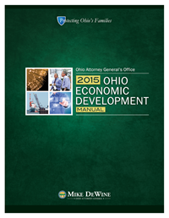
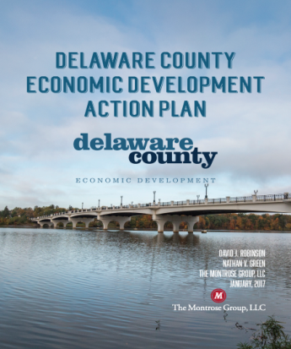

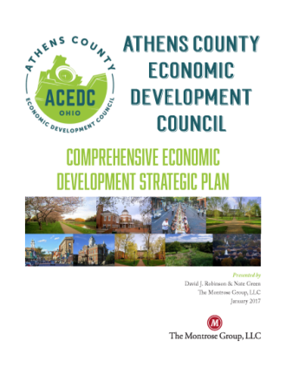

Montrose Group COVID 19 Economic Recovery Strategies:
Federal Stimulus CDBG
Montrose Group, LLC Wrote the Book on Economic Development

Slide 4




Montrose Group COVID 19 Economic Recovery Strategies:
Federal Stimulus CDBG
Dave Robinson
Tim Biggam
Nate Green
Jamie Beier Grant

Slide 5
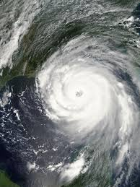

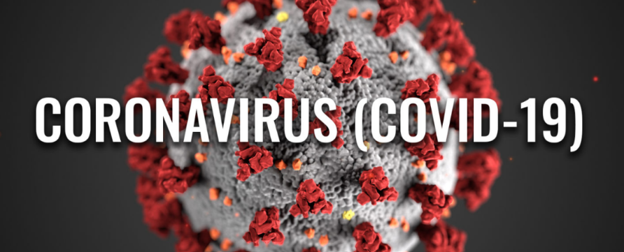
Montrose Group COVID 19 Economic Recovery Strategies:
Federal Stimulus CDBG

Slide 6
Montrose Group COVID 19 Economic Recovery Strategies:
Federal Stimulus CDBG
Montrose Group COVID 19 Economic Recovery Strategy
Business Development
Assess the Economic Impact

Slide 7
Montrose Group COVID 19 Economic Recovery Strategies:
Federal Stimulus CDBG
Assess Economic Damage
Job Postings Analytics
Input-Output Model
Skill Shape Analysis for Upskilling Opportunities
Supply Chain Analysis
Business Development
Site Development Plans
Build PPPs with local, state & federal funding
Community Centers
Housing Rehabilitation
Revolving Loan Funds
Workforce Development
Post-COVID 19 industry targets marketing strategy
Public Infrastructure for Projects

Slide 8
Montrose Group COVID 19 Economic Recovery Strategies:
Federal Stimulus CDBG
Assess COVID 19 Economic Impact
  JPMorgan estimates the Q1 2020 world economy GDP will decline 12%
  10M Americans filed for unemployment the last two weeks of March 2020
  US restaurants report in March laying off 3 M workers & losing sales of $25 B
  St. Louis Federal Reserve estimates COVID 19
    Could cost 47 M jobs
    Increase the unemployment rate past 32%
    Put at risk 67 M American jobs

Slide 9
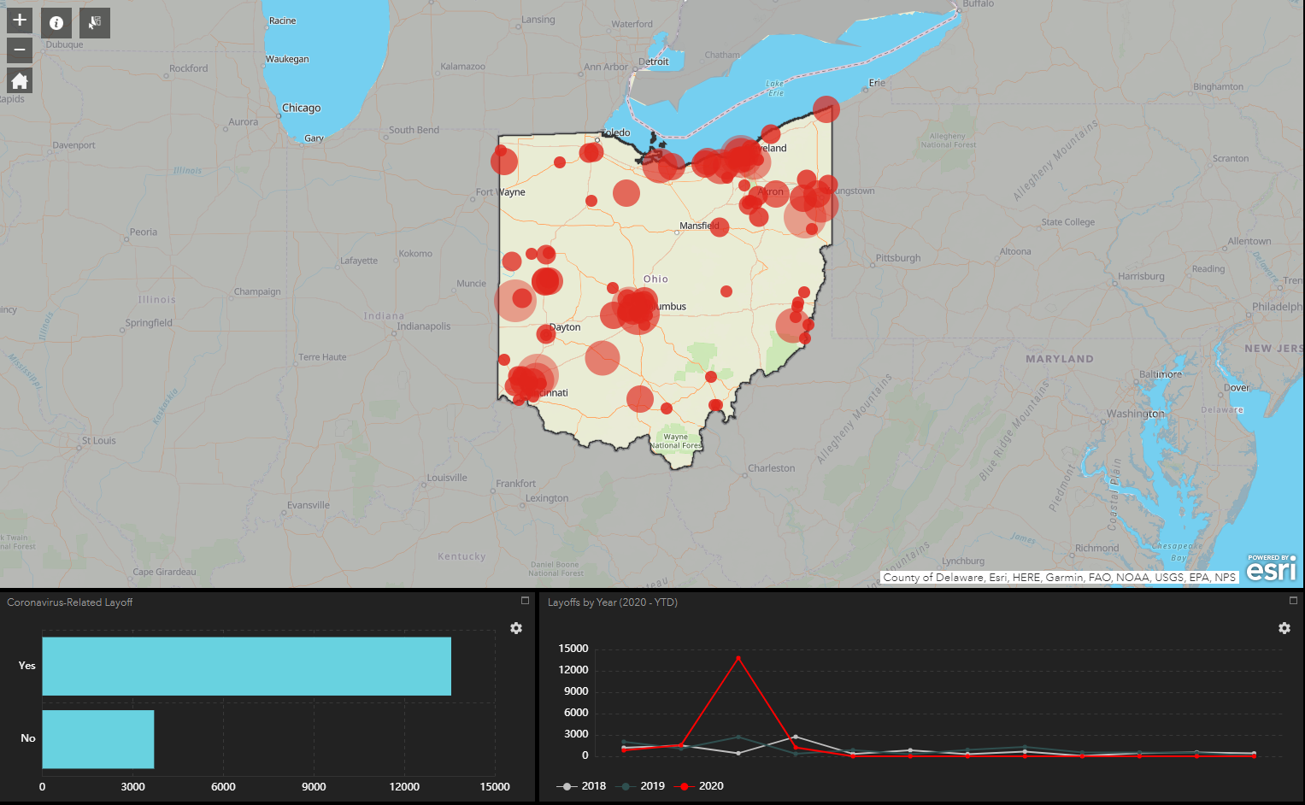
Montrose Group COVID 19 Economic Recovery Strategies:
Federal Stimulus CDBG
~75% related to COVID 19
Major metro areas hit hard
Dramatic spike in WARN notice layoffs of over 14,000 on March 1, 2020 vs. 709 in 2019
SE Ohio and eastern rural communities also hit hard
Most layoffs are temporary
Mix of facilities partially and fully closed as result of COVID 19
Mix of industry sectors
Assess COVID 19 Economic Impact
Source: JobsOhio

Slide 10
Montrose Group COVID 19 Economic Recovery Strategies:
Federal Stimulus CDBG
Assess COVID 19 Economic Impact
  Moody’s categorized leading industry sectors by level of risk as a result of COVID 19 as immediate, near-term and long-term which gives perspective on timelines for industry sector vulnerabilities
  Immediate includes air transportation, motor vehicle and parts, gasoline stations, merchandise and clothing stores, pipeline transportation, accommodation, food services and recreation
  Near-term includes construction, durable and nondurable goods manufacturing, real estate, administrative and support services, apparel manufacturing
  Long-term includes utilities, food manufacturing, food and beverage stores, professional and technical services, monetary and insurance-related sectors, and healthcare sectors

Slide 11
Montrose Group COVID 19 Economic Recovery Strategies:
Federal Stimulus CDBG
Assess COVID 19 Economic Impact
  Nationally, ~25-30% of small business establishments are in the immediate risk category, which collectively employs more than 27.5 M Americans
  Small businesses in the near-term risk category adds up to another 28% of establishments, meaning over 54% of U.S. small businesses are in very vulnerable positions, impacting roughly 47.8 M jobs.
  Biggest issue = liquidity
  How do federal, state and local policies and programs generate resources to give small business access to liquidity?

Slide 12
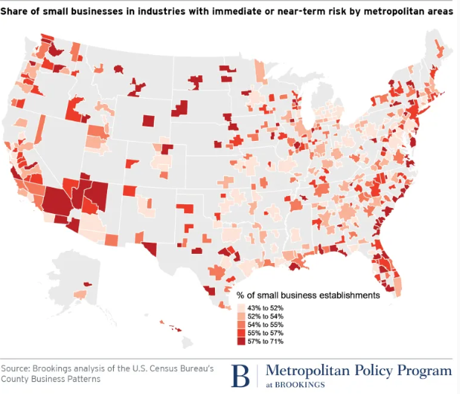
Montrose Group COVID 19 Economic Recovery Strategies:
Federal Stimulus CDBG

Slide 13
Montrose Group COVID 19 Economic Recovery Strategies:
Federal Stimulus CDBG
Source: Investment Strategy Group, Committee for a Responsible Federal Budget

Slide 14
Montrose Group COVID 19 Economic Recovery Strategies:
Federal Stimulus CDBG
Federal Stimulus & CDBG Programming
$2 B distributed by 2020 allocation to large cities and states
$5 B in COVID 19 federal stimulus funding
$1 B distributed to states in 45 days to combat COVID 19
$2 B distributed to states for longer term economic and housing disruptions

Slide 15
Montrose Group COVID 19 Economic Recovery Strategies:
Federal Stimulus CDBG
Federal CDBG Overview
Develop viable communities by supporting integrated approaches to:
HUD Office of Community Planning & Development
HUD develops partnerships with all levels of government, private sector for-profit and non-profit organizations
Decent housing options
Suitable living environments, and
Expanded economic opportunities for low- and moderate-income persons

Slide 16
Montrose Group COVID 19 Economic Recovery Strategies:
Federal Stimulus CDBG
Federal CDBG Overview
Federal CDBG Programs
Entitlement Program – annual grants on a formula basis to entitled cities and counties to develop viable urban communities via decent housing/living environment and expanding economic opportunities
Section 108 Loan Guarantee Program – CDBG recipients can leverage their annual grant allocation to access low-cost, flexible financing for ED, housing, public facility, and infrastructure projects; often used to catalyze private economic activity in underserved areas or fill gap financing in important community project; flexible repayment terms make it ideal for layering with other sources of community and ED financing including New Markets Tax Credits, Low Income Housing Tax Credits and Opportunity Zone equity investments
Principal cities of MSAs
Other metro cities with populations of at least 50,000
Qualified urban counties with populations of at least 200,000 (excluding population of entitled cities)

Slide 17
Montrose Group COVID 19 Economic Recovery Strategies:
Federal Stimulus CDBG
Federal CDBG Overview
Federal CDBG Programs
Colonias Set-Aside – special allocation to residential neighborhood projects along the border states of Arizona, California, New Mexico and Texas (United States-Mexico border region)
Disaster Recovery Program – grants to help cities, counties and states recover from Presidentially declared disasters, especially in low-income areas
HUD Administered Non-Entitled Counties in Hawaii Program – sources of funding for ED, housing rehabilitation, public facilities, construction or installation for the benefit of LMI persons in non-entitled Hawaiian counties

Slide 18
Montrose Group COVID 19 Economic Recovery Strategies:
Federal Stimulus CDBG
Federal CDBG Overview
Insular Areas Program – for U.S. territories (i.e., American Samoa, Guam, U.S. Virgin Islands)
Federal CDBG Programs
Recovery Housing Program – allows states and the District of Columbia to provide stable, transitional housing for individuals in recovery from substance-use disorder; funding covers a period of not more than 2 years or until the individual secures permanent housing, whichever is earlier
Neighborhood Stabilization Program – providing emergency assistance to stabilize communities with high rates of abandoned and foreclosed homes and to assist households whose annual incomes are up to 120% of the area median income
State Program – states award grants to smaller units of general local government that develop and preserve decent affordable housing, provide services to the most vulnerable in communities, and create and retain jobs

Slide 19
Montrose Group COVID 19 Economic Recovery Strategies:
Federal Stimulus CDBG
CDBG National Objectives
Employing at least 51% low-and moderate-income persons
Elimination of slum and blight
Meet an “urgent” business or community need

Slide 20
Montrose Group COVID 19 Economic Recovery Strategies:
Federal Stimulus CDBG
CDBG Funds
Infrastructure
Economic development projects
Public facilities installations
Community centers
Housing rehabilitation
Public services
Microenterprise assistance
CDBG Funds
Fund up to 50% of total project costs, not to exceed $500,000
Up to $10,000 can be granted or loaned for every full-time equivalent job created or retained as a result of the project
Public infrastructure projects (e.g., water, sewer, roads) are eligible for up to 50% CDBG grant funding, not to exceed $500,000, towards project
Private, for-profit projects can qualify for up to 50% CDBG low-interest loans, not to exceed $500,000 towards project

Slide 21
Montrose Group COVID 19 Economic Recovery Strategies:
Federal Stimulus CDBG
Public Infrastructure + Private CapEx
Major manufacturer in rural Midwest county with expansion needs to bring outsourced process in-house to enhance quality control measures
New public water/sewer/storm sewer/road extension to expanded facility necessary
Total Private + Public Project Investment - $2.7 M
CDBG Infrastructure Grant - $310,000 ($9,394/job)
Private Financing - $2.4 M
New Jobs Created – 33
Commitment to LMI Jobs – 20 (60.6%)

Slide 22
Montrose Group COVID 19 Economic Recovery Strategies:
Federal Stimulus CDBG
Economic Development Planning Project - $12 M
Missouri Community Colleges “Training for Tomorrow” initiative in disaster areas of state (tornadoes and flooding recovery)
12 County governments in disaster impacted areas applied for CDBG funds on behalf of community colleges
Increase capacity of Missouri CC’s to develop new and expanded programs to retrain and re-employ Missourians in middle-skill occupations that are geared towards economic recovery; priorities included:
Capacity building actions to develop new programs for workforce market demands
Proof of alignment with local economic recovery efforts
Creation and addition of specific high demand career pathways
Detailed implementation plan for program use and long-term disaster recovery strategies

Slide 23
Montrose Group COVID 19 Economic Recovery Strategies:
Federal Stimulus CDBG
Section 108 Guaranteed Loan - $1.77 M
City of Tuscon, AZ received $20 M in loan guarantee assistance funding from HUD for “Economic & Community Development Loan Pool” for gap financing between $2 M - $10 M per project
Section 108 Payback Schedule - $100,000 plus interest annually/17 yrs, final balance payment of $69,000 in year 18
National Objective – removal of barriers to mobility/accessibility of elderly and disabled persons as well as benefiting persons of at least 51% low-and moderate-income
City undertook $101 M street/sidewalk project, which included installation of ADA improvements, and used $1.77 M Section 108 guaranteed loan along with $100 M in General Obligation Bonds
City used annual CDBG allocation for loan repayments and pledged its full faith and credit to repay loan
Additional Benefits – enhance safety, increase access into resident and business districts, access to community facilities and public transit

Slide 24
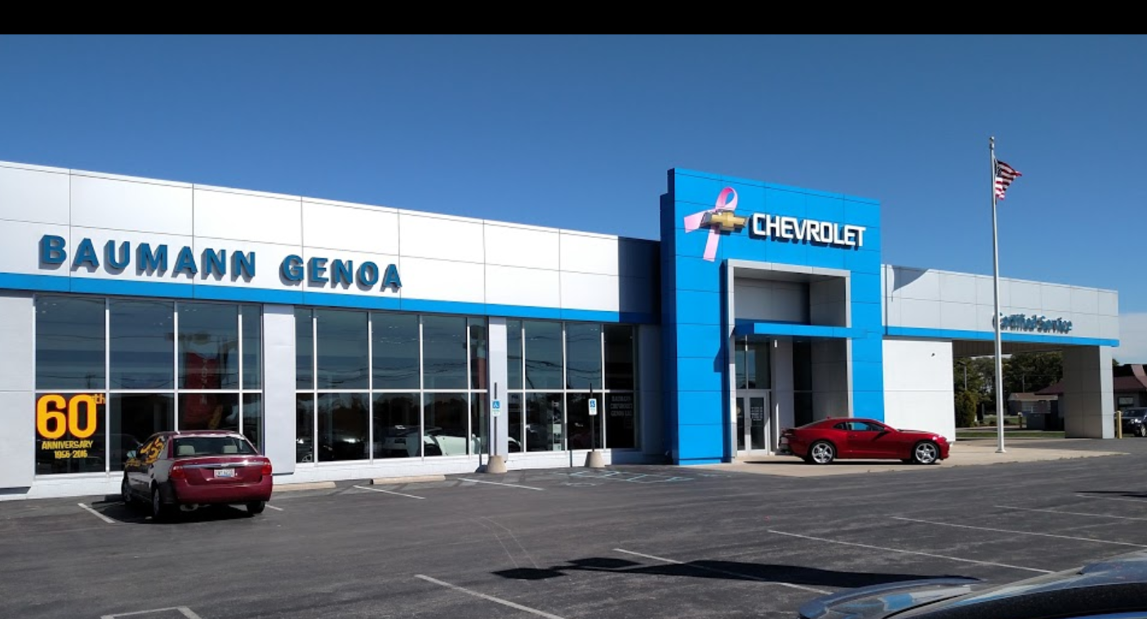
Montrose Group COVID 19 Economic Recovery Strategies:
Federal Stimulus CDBG
CDBG State Requested RLF
Gap financing request to state to rebuild automotive dealership
Dealership required by automaker to rebuild facility
Total Project Cost - $1.5 M
CDBG state request - $500,000
Ultimately seeded local CDBG RLF program

Slide 25
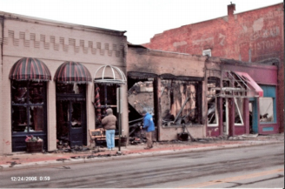
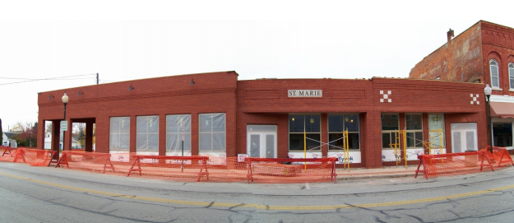
Montrose Group COVID 19 Economic Recovery Strategies:
Federal Stimulus CDBG
CDBG Local Requested RLF
Gap financing request to state & local RLF to rebuild historic restaurant in downtown district
Business destroyed by fire
Local CDBG RLF request - $68,100
CDBG state request - $199,900
Total Project Cost - $650,000

Slide 26
Montrose Group COVID 19 Economic Recovery Strategies:
Federal Stimulus CDBG
Ohio Development Services Agency
Office of Community Development

Slide 27

Montrose Group COVID 19 Economic Recovery Strategies:
Federal Stimulus CDBG
Ohio Development Services Agency
Office of Community Development
Mary R. Oakley
Manager, Community Investments
Office of Community Development
614-644-9226
Mary.Oakley@development.ohio.gov

Slide 28
Montrose Group COVID 19 Economic Recovery Strategies:
Federal Stimulus CDBG
U.S. Department of Housing and Urban Development (HUD)
Ohio Development Services Agency
Office of Community Development
Small Cities and Rural Counties

Slide 29
Community Development Block Grant Programs
Economic Development
Economic Development
Residential Public Infrastructure
Target of Opportunity
Downtown
Housing
Home Repair
Allocation
Revolving Loan Fund
Community Development
Critical Infrastructure
Neighborhood Revitalization
Water
Sanitary Sewer
Community Development
Economic Development
Rehabilitation
Emergency Monthly Housing Payments

Slide 30
Modifications
Emergency Shelter Funding Gap Program
Public Service Waivers/Amendments
Housing: Emergency Monthly Housing Payments

Slide 31
Revolving Loan Fund Modifications
O% interest loans
6- to 12-month principal/interest deferrals
Working capital loans

Slide 32
CARES Act
$2 billion Formula
$1 billion States
$2 billion Formula (COVID-19)
  State: $27 million
  Entitlements: $64 million
  30 days
  State: $35 million
  45 days
  Funding: TBD
  Rolling basis

Slide 33
CARES Act
CDBG
Homeless Services
Public Health Services
Senior Services

Slide 34
Next Steps
Collaborate with Community Action Agencies to identify needs
Amend Annual Action Plan
Create Application Process

Slide 35
Montrose Group COVID 19 Economic Recovery Strategies:
Federal Stimulus CDBG
Rethinking & Repositioning Economic Efforts Post Crisis

Slide 36
Montrose Group COVID 19 Economic Recovery Strategies:
Federal Stimulus CDBG
Montrose Group CDBG
Economic Recovery Approach
Community Strategic Plan Evaluation
Identify Economic Recovery Initiatives & Priorities
Roadmap for Implementing Initiatives & Priorities
Economic Recovery Advocacy

Slide 37
Montrose Group COVID 19 Economic Recovery Strategies:
Federal Stimulus CDBG
Community Strategic Plan Evaluation
Review of community strategies and identify areas for COVID 19 realignment
Industry Cluster Analysis to define region’s economic strengths
Incorporate Business & Workforce Needs Assessment as a result of COVID 19 crisis

Slide 38
Montrose Group COVID 19 Economic Recovery Strategies:
Federal Stimulus CDBG
Identify Recovery Initiatives & Priorities
Position economic competitiveness sectors to identify post-COVID 19 development opportunities
Map out existing resources and gaps for BRE and Business Attraction
Consider organizational post-COVID 19 policies & procedures

Slide 39
Montrose Group COVID 19 Economic Recovery Strategies:
Federal Stimulus CDBG
Roadmap for Implementing Initiatives & Priorities
Position economic competitiveness sectors to identify post-COVID 19 development opportunities
Site development plans to focus on post-disaster needs
Logistics
PPEs
PhRMA

Slide 40
Montrose Group COVID 19 Economic Recovery Strategies:
Federal Stimulus CDBG
Economic Recovery Advocacy
Consider and pursue policy and program changes to position community or region for investment opportunities in post-disaster environment
Advocacy for industry sector business attraction campaigns, site development and BRE programs to assist existing economic base
CDBG Funding for project public infrastructure
CDBG Funding for workforce development program

Slide 41
Montrose Group COVID 19 Economic Recovery Strategies:
Federal Stimulus CDBG
Economic Recovery for Small Businesses
Outlining options for small business liquidity access
Local financial institutions, CDFIs, small business development intermediaries, real estate developers
Creation of small business stabilization funds
Connect to CARES Act resources
SBA Stimulus Money
CDBG Funding
Follow federal government for possible CARES Act 2.0
Creation of Revolving Loan Fund

Slide 42
Montrose Group COVID 19 Economic Recovery Strategies:
Federal Stimulus CDBG
Conclusions
Thoughts
Questions
Contact
drobinson@montrosegroupllc.com
ngreen@montrosegroupllc.com
jbgrant@montrosegroupllc.com
Mary.Oakley@development.ohio.gov
tbiggam@montrosegroupllc.com

