Slide 1
Site Development Fundamentals
Dave Robinson
Nate Green
Jamie Beier Grant
Montrose Group, LLC

Slide 2
Site Development Fundamentals
Montrose Group
Land Use Entitlements
Tax Incentives
Infrastructure Finance
Compensation Agreements
Construction Financing
Notes:
A Trend
General direction in which something is developing or changing
The mullet haircut was a poor fashion decision
The shift to a global economy was a long-term shift in the general direction of the economy
The art of economic development is understanding what is truly a shift in the general direction of the economy and what is just a fad.

Slide 3




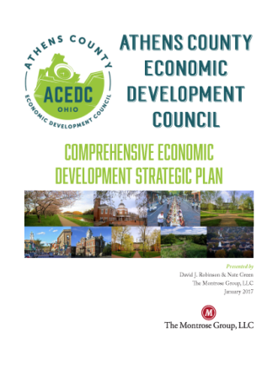

Site Development Fundamentals
Montrose Group, LLC Wrote the Book on Economic Development

Slide 4
Site Development Fundamentals
Land use and Economic Development
Economic Development cannot occur without land use regulation authorizing the type of use for the land on which the development sits.
Land use regulation usually includes traditional or “Euclidian” Zoning, mixed use, and no-zoning.

Slide 5
Site Development Fundamentals
Municipal/County Planning and Zoning
Planning Commissions are comprised of elected officials and citizens.
Create maps, plans, studies, recommendations, etc.
Responsible for initial review of new zoning ordinances or amendments to existing zoning ordinances.
Enforces zoning and building codes.
Acts as a quasi-judicial body when deciding appeals of zoning ordinances.

Slide 6
Site Development Fundamentals
Zoning Applications
Traditional Zoning
Establishes distinct districts.
Each district includes development requirements (minimum lot area, width, yard depth, etc.).
Outlines the procedures for appeal of a zoning code amendment, decision, application for a variance, and approval for conditional uses.

Slide 7
Site Development Fundamentals
Traffic and infrastructure analysis
County Final Approval
Pre-zoning amendment application briefings
Project ROI analysis
Zoning amendment application
Zoning Commission approval
Trustee/City Council Approval
County/City Planning Commission approval
Zoning Certificate
Zoning Process

Slide 8
Site Development Fundamentals
Rickenbacker
Global
Logistics
Park &
Beyond

Slide 9
Site Development Fundamentals
Annexation
Legal process by which land located in an unincorporated area may become part of a neighboring city or village
The unincorporated neighboring land must be immediately contiguous to the existing city’s boundaries
Delivery of municipal services or economic development in need of municipal services is generally the reason for annexation

Slide 10
Site Development Fundamentals
Annexation National Survey
States generally require annexed land to be contiguous or connected physically to a city, but 14 states do make exceptions for non-contiguous property
20 states require a public service plan
7 states require fiscal impact reports
Majority of states require cities to annex thru ordinance but half require some form of election
Push for more public engagement

Slide 11
Site Development Fundamentals
Arizona Annexations
Territory must adjoin the city boundary for at least 300 feet unless surrounded on three sides
Size and the shape must be 200 feet wide at all points not including the rights-of-way and roadways
Must independently meet the length and width requirements
Only unincorporated territory and it may not create an island of unincorporated territory
Requires public notice followed by petition circulation in support for the annexation
Requires that fire districts be notified
Phoenix
1950, Phoenix was 17 square miles with 100,000 population
2020, Phoenix is over 500 square miles with 1.4 M population

Slide 12
Site Development Fundamentals
Infrastructure Finance
Tax Increment Finance
Transportation Improvement Districts
State Funding

Slide 13
Site Development Fundamentals
Tax Increment Financing
Step | Description | Amount
1. Base Value | The total market value of real property prior to enactment of TIF legislation. | $1,000,000
2. New Value | The new market value after TIF was created and investment occurred. | $11,000,000
3. Growth in Market Value | The difference between the Base value and new value | $10,000,000
4. Assessed Value | 35% of new market value | $3,500,000
5. Annual Tax Increment/PILOT | The assessed value times the tax rate ($3,500,000 X .075) available on an annual basis for PILOT | $262,500

Slide 14
Site Development Fundamentals
TIFs
The purpose of using a TIF is to generate payments in lieu of taxes (PILOTs) to pay for public infrastructure improvements
All existing taxes are unaffected
County treasurer collects PILOTs along with real estate taxes
PILOTs are in the same amount as otherwise applicable taxes
Parcel TIF versus Incentive District TIF (300 acres)
School District and overlapping taxing district issues, public notice and compensation
TIF Agreement

Slide 15
Site Development Fundamentals
TIF Funded Public Infrastructure
More traditional governmental projects such as roads, water & sewer lines, storm water, etc.
Redevelopment projects (e.g. land acquisition, land preparation, environmental remediation and demolition)
New development projects and related infrastructure improvements, e.g. gas, electric and other utility type services, e.g. communication, cable, etc.
Projects can sometime be located on privately owned properties

Slide 16
Site Development Fundamentals
TIF Approaches
Cash Advance
State Loan
Bond Financing
Public body can make a cash advance out of its available funds, with the intent of reimbursing itself out of future PILOTs.
Public body might seek to obtain a state loan and use TIF PILOTs to repay the state loan.
Industrial revenue bonds, general obligation bonds or other obligations to pay debt service in whole or in part out the PILOTs.

Slide 17
Site Development Fundamentals
Potential Risks of TIFs:
Anticipated real property improvements are not completed or valued at anticipated level, resulting in lower PILOTs.
Real Property improvements are completed, but the improvements are damaged or destroyed, resulting in lower PILOTs.
Real Property Improvements are completed, but the property owner encounters financial difficulty and lacks ability to make TIF PILOTs.
Potential future decrease in level of assessed valuation and/or the level of real property taxation, resulting in lower PILOTs.
One solution Special Assessment Secured TIFs. Developer initiated petition.

Slide 18
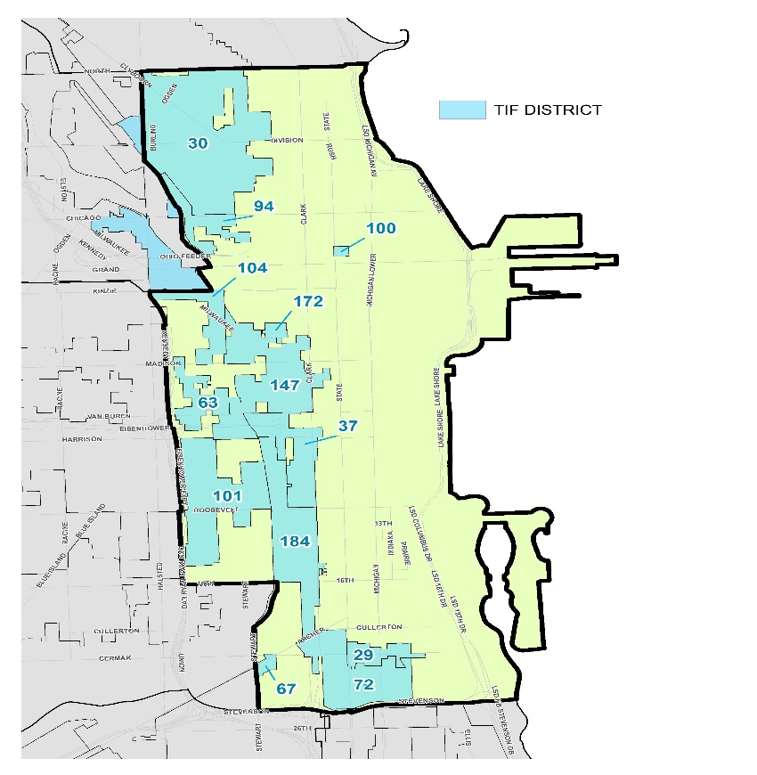
Site Development Fundamentals
Illinois TIF Program
Focused on underserved areas
Local governments can redirect additional tax revenues generated above a set amount within a designated TIF district for infrastructure improvements within the TIF
Funds improvements in streets, sewer, water lines, and historic properties, and for support infrastructure required for industrial/commercial use
Chicago Downtown TIF Map

Slide 19
Site Development Fundamentals
Joint Economic Development Options
Facilitate investment, cooperation and economic development between two or more contracting subdivisions
Allocate financial and budgetary burdens, risks and benefits as agreed between the contracting parties, e.g. pooling and sharing resources to facilitate the district’s growth
Two types
Joint Economic Development Districts (JEDD)
Municipal Utility District (Replaces JEDZ)

Slide 20
Site Development Fundamentals
Joint Economic Development Districts (JEDDs)
Parties negotiate a contract that defines the amount and nature of the contribution of each contracting party and the sharing of costs
District is governed by a board of directors
Contract may grant power for board of directors to levy an income tax in the district to generate revenue to facilitate the District’s purposes
Municipal corporations within the JEDD may issue revenue bonds to support new development

Slide 21

Site Development Fundamentals
Rickenbacker Global Logistics JEDD
Created in Pickaway County and the City of Columbus to expand commercial and industrial development in the area south of the Rickenbacker International Airport.
Estimated to bring in 15,000 to 20,000 jobs to central Ohio over the next 30 years.

Slide 22
Site Development Fundamentals
State & Local Infrastructure Funding
Local Government Closing Funds
State Government Infrastructure Grants & Loans
Intergovernmental Agencies

Slide 23


Site Development Fundamentals
Arizona City Closing Funds
Large scale, non-retail projects
1000 jobs or more
Municipal closing fund grants

Slide 24

Site Development Fundamentals
Advantage Maryland
Grants, loans, and other investment initiatives to support economic development initiatives including infrastructure support
Priority funding areas
Eligible industry sectors
Local sponsor
Major economic development projects may be eligible for up to $10 million in loan funding, municipalities may receive up to $5 million in loans or $2 million in loans and grants to support expanding businesses

Slide 25
Site Development Fundamentals
JobsOhio Ohio Site Inventory Program
$50 M annually over five years
Funds speculative job producing, non-retail infrastructure and building construction costs
Industry targets by region
$2-5 M
Should be 30 acres in size
Mixed use permitted in office projects if residential/multi-family is not more than 20%

Slide 26

Site Development Fundamentals
Greater Minnesota Public Infrastructure Grant Program
State grants to local communities
New economic growth, create new jobs, and retain existing jobs by investing in needed infrastructure
Cities or counties outside the seven-county Minneapolis-St. Paul metro
Wastewater collection, streets, and utility extensions
Local match of at least 50 % of project capital costs
Not exceeding $2 M in two years for one or more projects.

Slide 27
Site Development Fundamentals
Transportation Improvement Districts
ORC 5540.01 – TID’s
Promotes intergovernmental and public-private cooperation of transportation resources and investments
Purpose: To improve transportation systems that enhance, foster, and aid the promotion of transportation and economic development/economic welfare of the people within the TID area and state. TIDs must serve a public purpose.
Created by County Commissioners but operated by a Board of Trustees (bylaws, budget, taxing authority, staff)

Slide 28
Site Development Fundamentals
Transportation Improvement Districts cont’d.
Formed for the purpose of jointly planning and funding transportation networks and infrastructure
Board has power to pass levies and create special assessments to fund transportation projects, acquire property, contract for improvements, issues bonds, apply for other revenue, acquire property for transportation needs
Projects – streets, highways, parking facilities, bridges, etc.

Slide 29
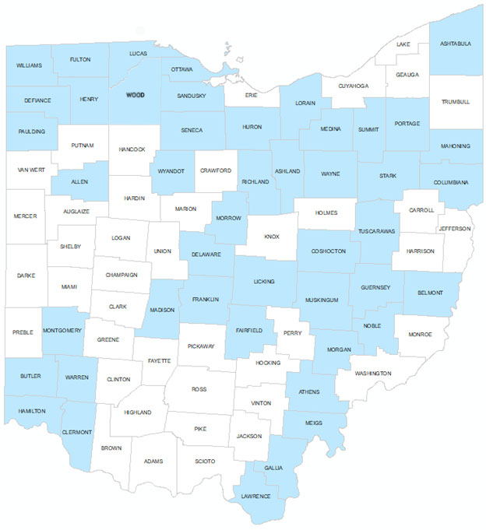
Site Development Fundamentals
Ohio’s 46 Transportation Improvement Districts
Ottawa County, OH TID
  Catalyst Project: OH-53 Improvements to Manage Industrial & Tourist Traffic Flows
  Multiple Partners & Funding Resources
  TID acts like project hub
    Identifies priorities
    leverage state and local funds
    incorporate private sector investments
    acquire land to widen state route

Slide 30
Site Development Fundamentals
Ottawa County, OH TID cont’d.
Voting Members – County Engineer, County Auditor, Sheriff, Regional Planning Commission, Economic Development Director
Ex-Officio Members – County Commissioners, State Representative, State Senator

Slide 31
Site Development Fundamentals
Definitions of Local Tax Abatement
Tax Abatement
A reduction in taxes
Based upon increased value
For a term of years

Slide 32
Site Development Fundamentals
National tax abatement survey
New investment
Targeted to undeserved areas
Historic Preservation
Industrial expansion
Residential expansion
Warehousing and distribution, processing
Telecommunications
Tourism
R&D
Finance, insurance
Daycare service
Job creation
Annual reporting
Focus on

Slide 33
Site Development Fundamentals
Enterprise Zones
40 states
Real & personal property tax exemption from new investment
High-wage job creation & capital investment
Distressed Based or Non-Distressed Based EZ
New, existing, vacant, or renovation of an existing facility
Relocation permitted
Designated area

Slide 34
Site Development Fundamentals
Enterprise Zones
Retail exception for impacted cities
Process-state authorized, locally negotiated
Key negotiations terms
Exemption percentage- above 75% require school approval
Term
Geographic location
Local worker hiring
Clawback

Slide 35
Site Development Fundamentals
Community Reinvestment Areas
Designated area
Real property tax exemption from new investment
High-wage job creation, capital investment & housing
New, existing, vacant, or renovation of an existing facility
Relocation permitted
Housing survey required

Slide 36
Site Development Fundamentals
Iowa’s High-Quality Job Creation Program
Local property tax abatement of up to 100 percent of the value added to new, expanded, or modified property
Refund of state sales, service, or use taxes paid to contractors or subcontractors during construction
Refund of sales and use taxes paid on specified equipment
Amortized investment tax credit equal to a percentage of the qualifying investment

Slide 37
Site Development Fundamentals
Tax Credit
A reduction in taxpayer liability for taxes levied by the government.
Refundable tax credits
Require that the government make an actual payment of the credit amount owing to a taxpayer as calculated under the applicable tax credit law even if the taxpayer does not have a tax liability.
Non-Refundable tax credits
The government levying the tax need not pay the taxpayer the amount of credit if the taxpayer has no tax liability owing to the government levying the tax.

Slide 38
Site Development Fundamentals
20 Different State Economic Development Tax Credits
R&D
Renewable energy
Job creation
Workforce training
Building daycare facilities
Corporate HQ
Small business investment
Infrastructure
Technology investment
Historic preservation
New Market Tax Credit

Slide 39

Site Development Fundamentals
Georgia Quality Jobs Tax Credit
Create 50 "high-paying jobs" in 24 months paying at least 10% above the average county wage
Higher wage jobs create large tax credit
If the credit lowers corporate tax liability to zero, credits then apply to a company's payroll witholding tax liability.

Slide 40
Site Development Fundamentals
Compensation Agreements
PILOT agreement that provide payments to local government entities for “forgone” tax payments
Tax revenue split among local governments and schools
Developer payments to school districts

Slide 41
Site Development Fundamentals
Compensation Agreement Model
Local Government Revenue Sharing
JEDD Creates Income Tax for City, Township & Infrastructure Funding
TIF Creates Revenue Funding for Schools & Infrastructure Funding
Developer Provides PILOT Payment Through Real Estate Charge

Slide 42
Site Development Fundamentals
Property Assessed Clean Energy (PACE) Financing
Finances up to 100% of energy efficiency investments in buildings through “off the books” property assessments
Property owners self-assess the property to gain capital for energy efficiency investments and repay the loan over time
Debt secured by lien on property and remains with the property for up to 20 years
Other debt holders must consent to PACE financing
Private sector and Public sector can use PACE financing

Slide 43
Site Development Fundamentals
PACE eligible expenses
Retrofits or Energy Projects
Doors, windows and building envelope
Climate control
Cooling roofing
Insulation
Water efficiency
Natural disaster preparedness
Lighting
Solar Power

Slide 44

Site Development Fundamentals
Boulder Colorado PACE Program
Began in 1993 as a partnership of local governments and businesses
More than 300 businesses and municipal operations across Boulder County (20 percent of all businesses and operations) are PACE certified

Slide 45
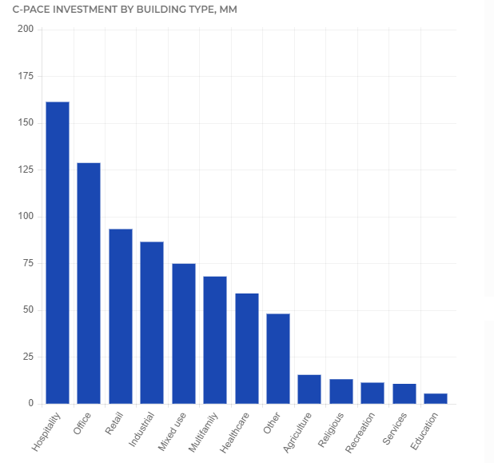
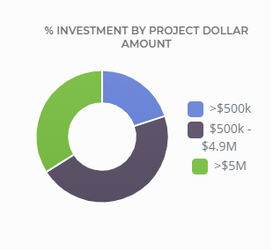
Site Development Fundamentals
Source: PACE Nation

Slide 46
Site Development Fundamentals
Conclusions
Thoughts
Questions
Contact
drobinson@montrosegroupllc.com
ngreen@montrosegroupllc.com
jbgrant@montrosegroupllc.com

